Slide 1
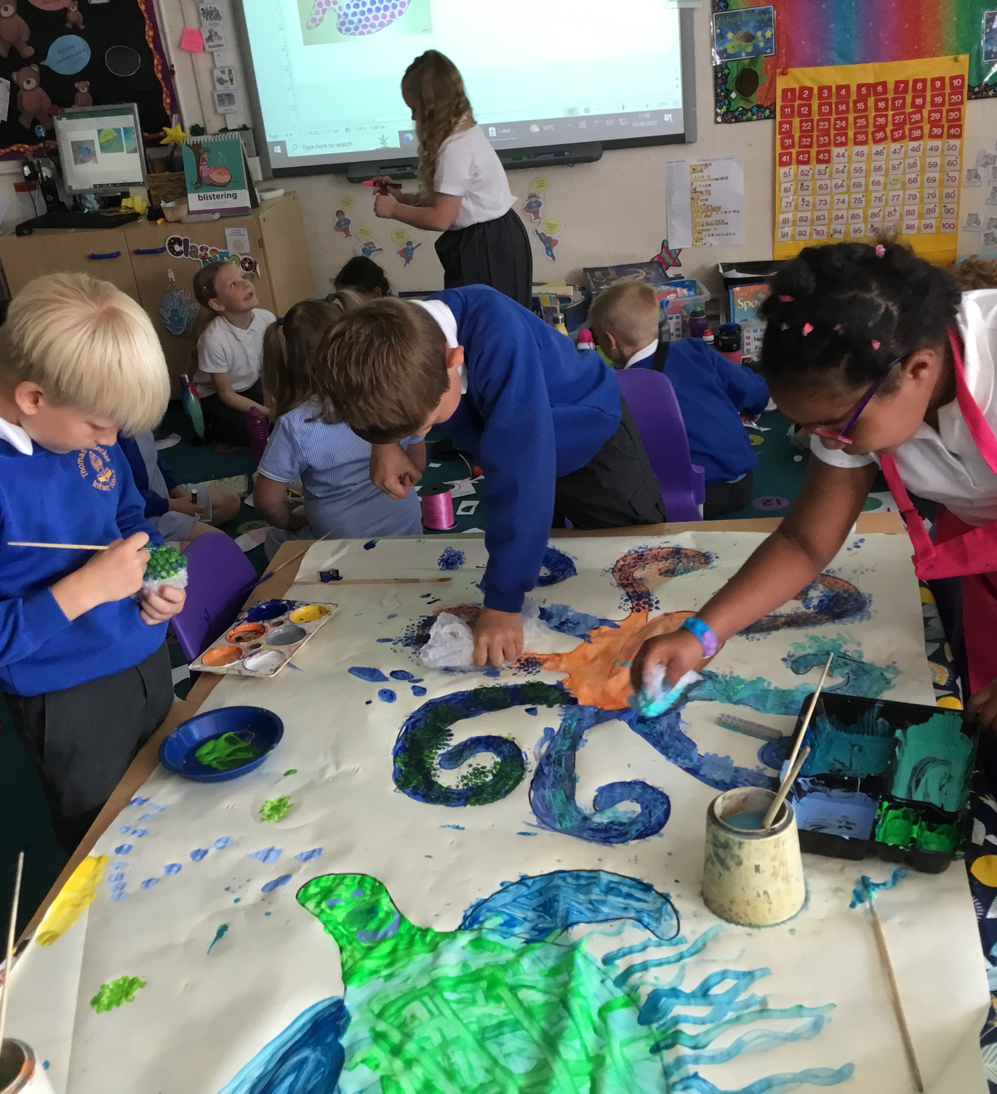
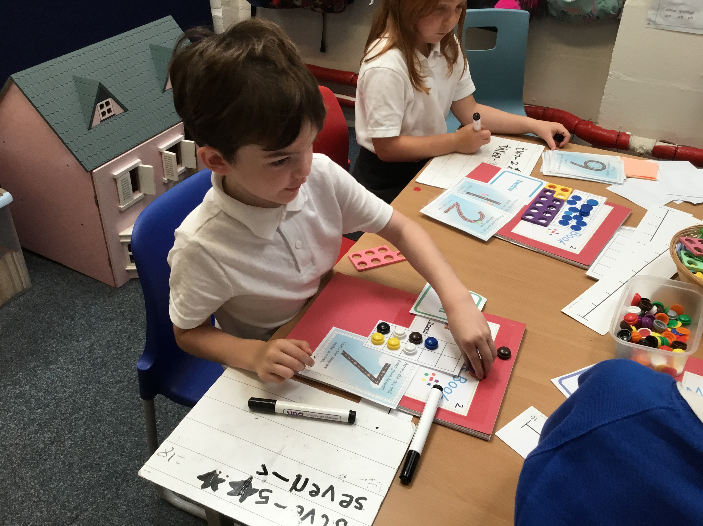
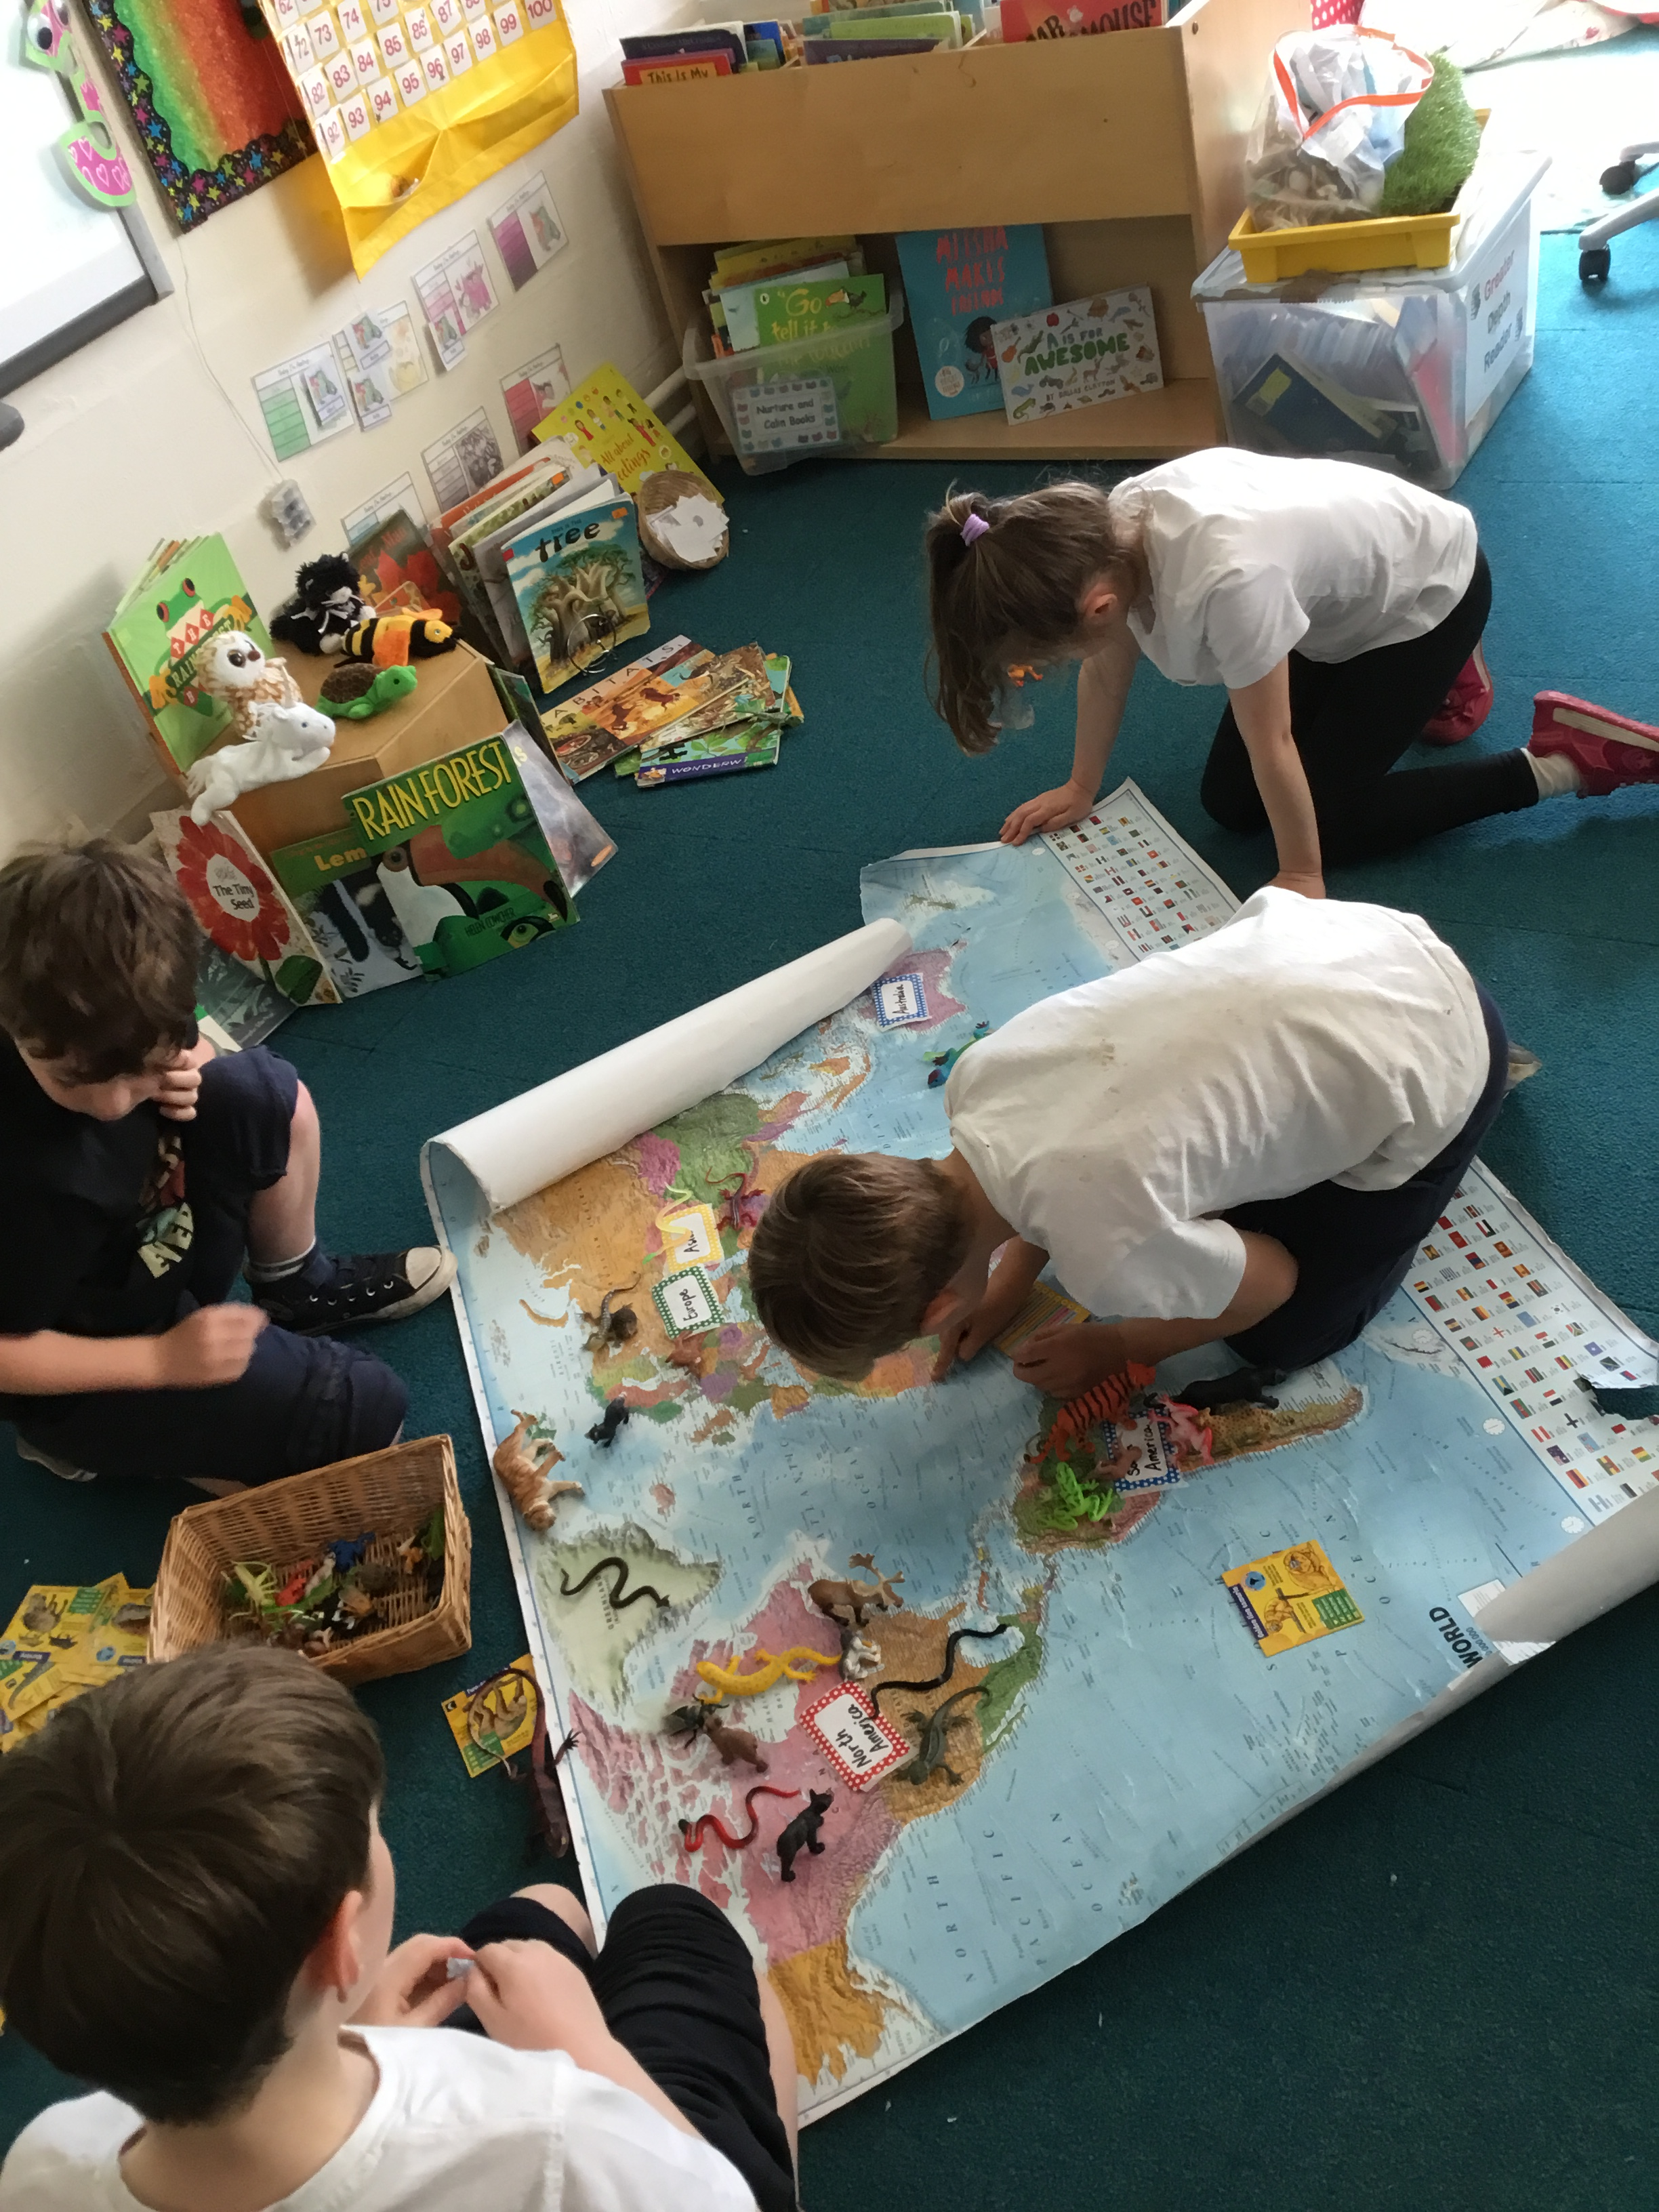
Welcome to Year 2!

Slide 2
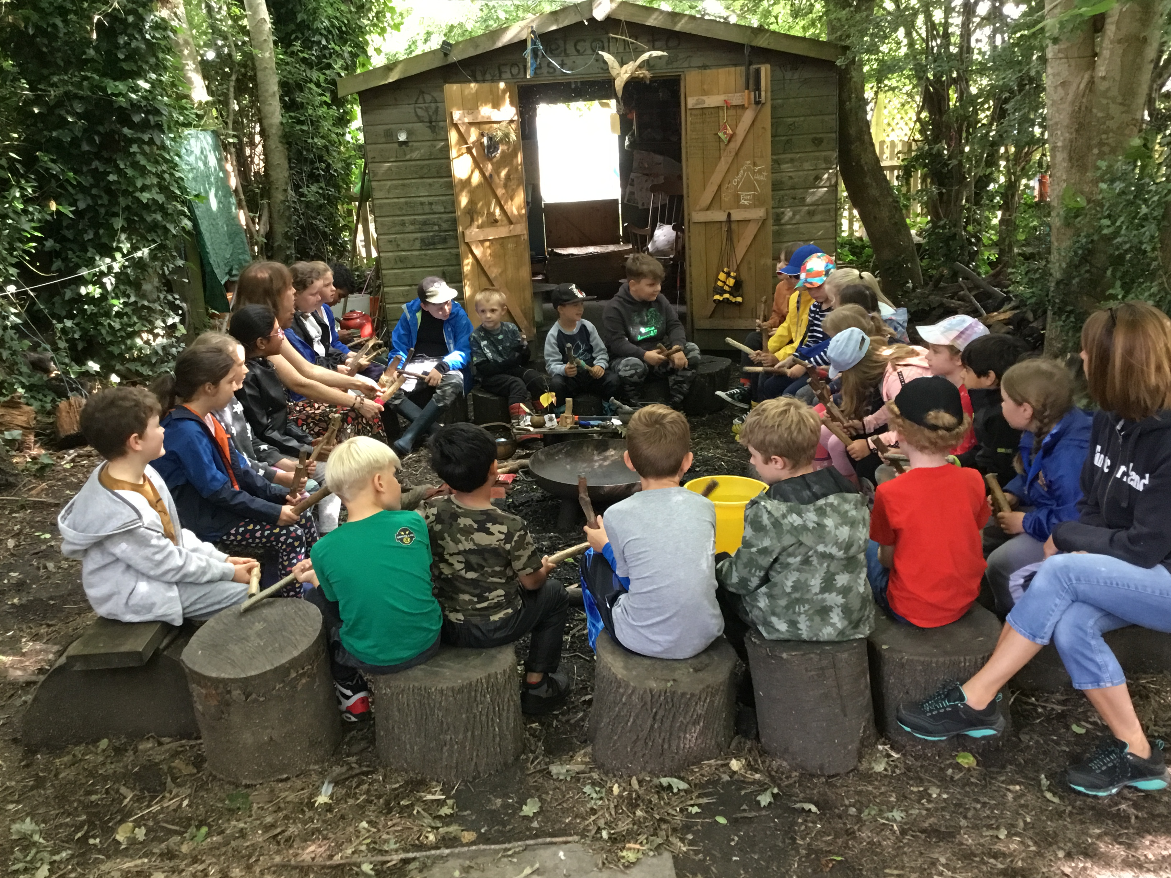
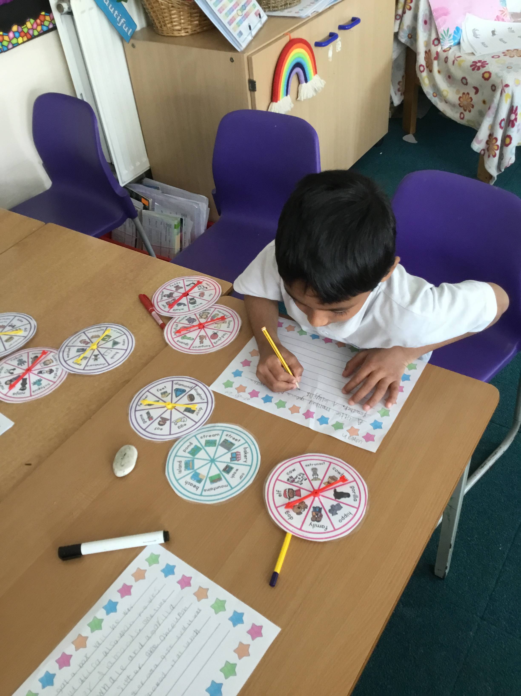
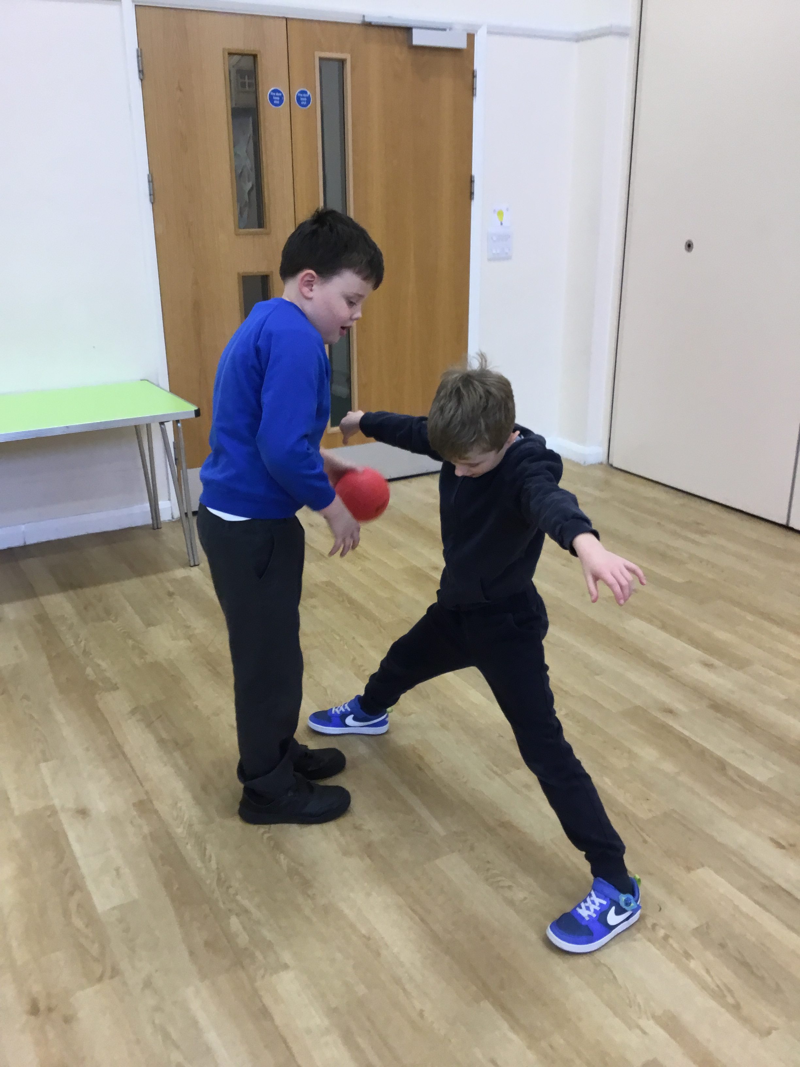
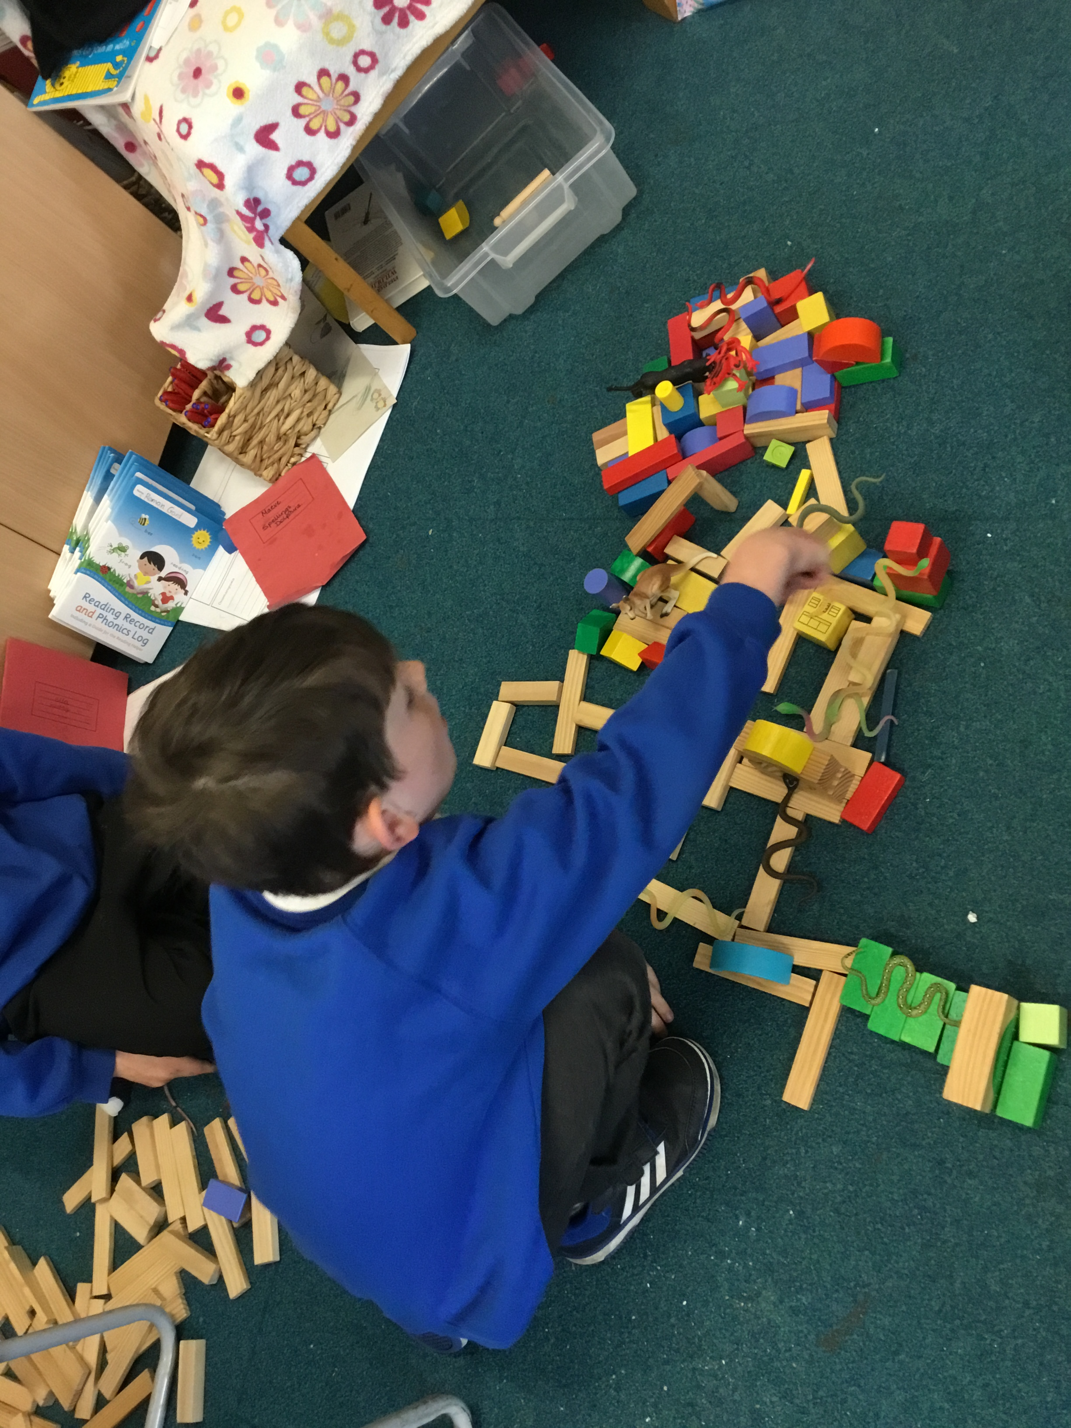
Transition from Year 1 to Year 2
In Year 2 your child will continue to work within Key Stage 1. We will be developing the basic skills that they have acquired in Year 1 and consolidating them.
Throughout the week the children will have Continuous Provision, which we call COOL Time (Continue Our Own Learning Time).
In our classrooms the children will have access to Art and DT Workshop, Small World Area, Construction Area, Role Play Area, Writing Area.
The children also have access to our Outdoor Area and will continue their enrichment of Forest School learning throughout the year.
Children will have two sessions of PE, Indoor PE with a focus on gymnastics and dance and an Outdoor Session of skills.

Slide 3
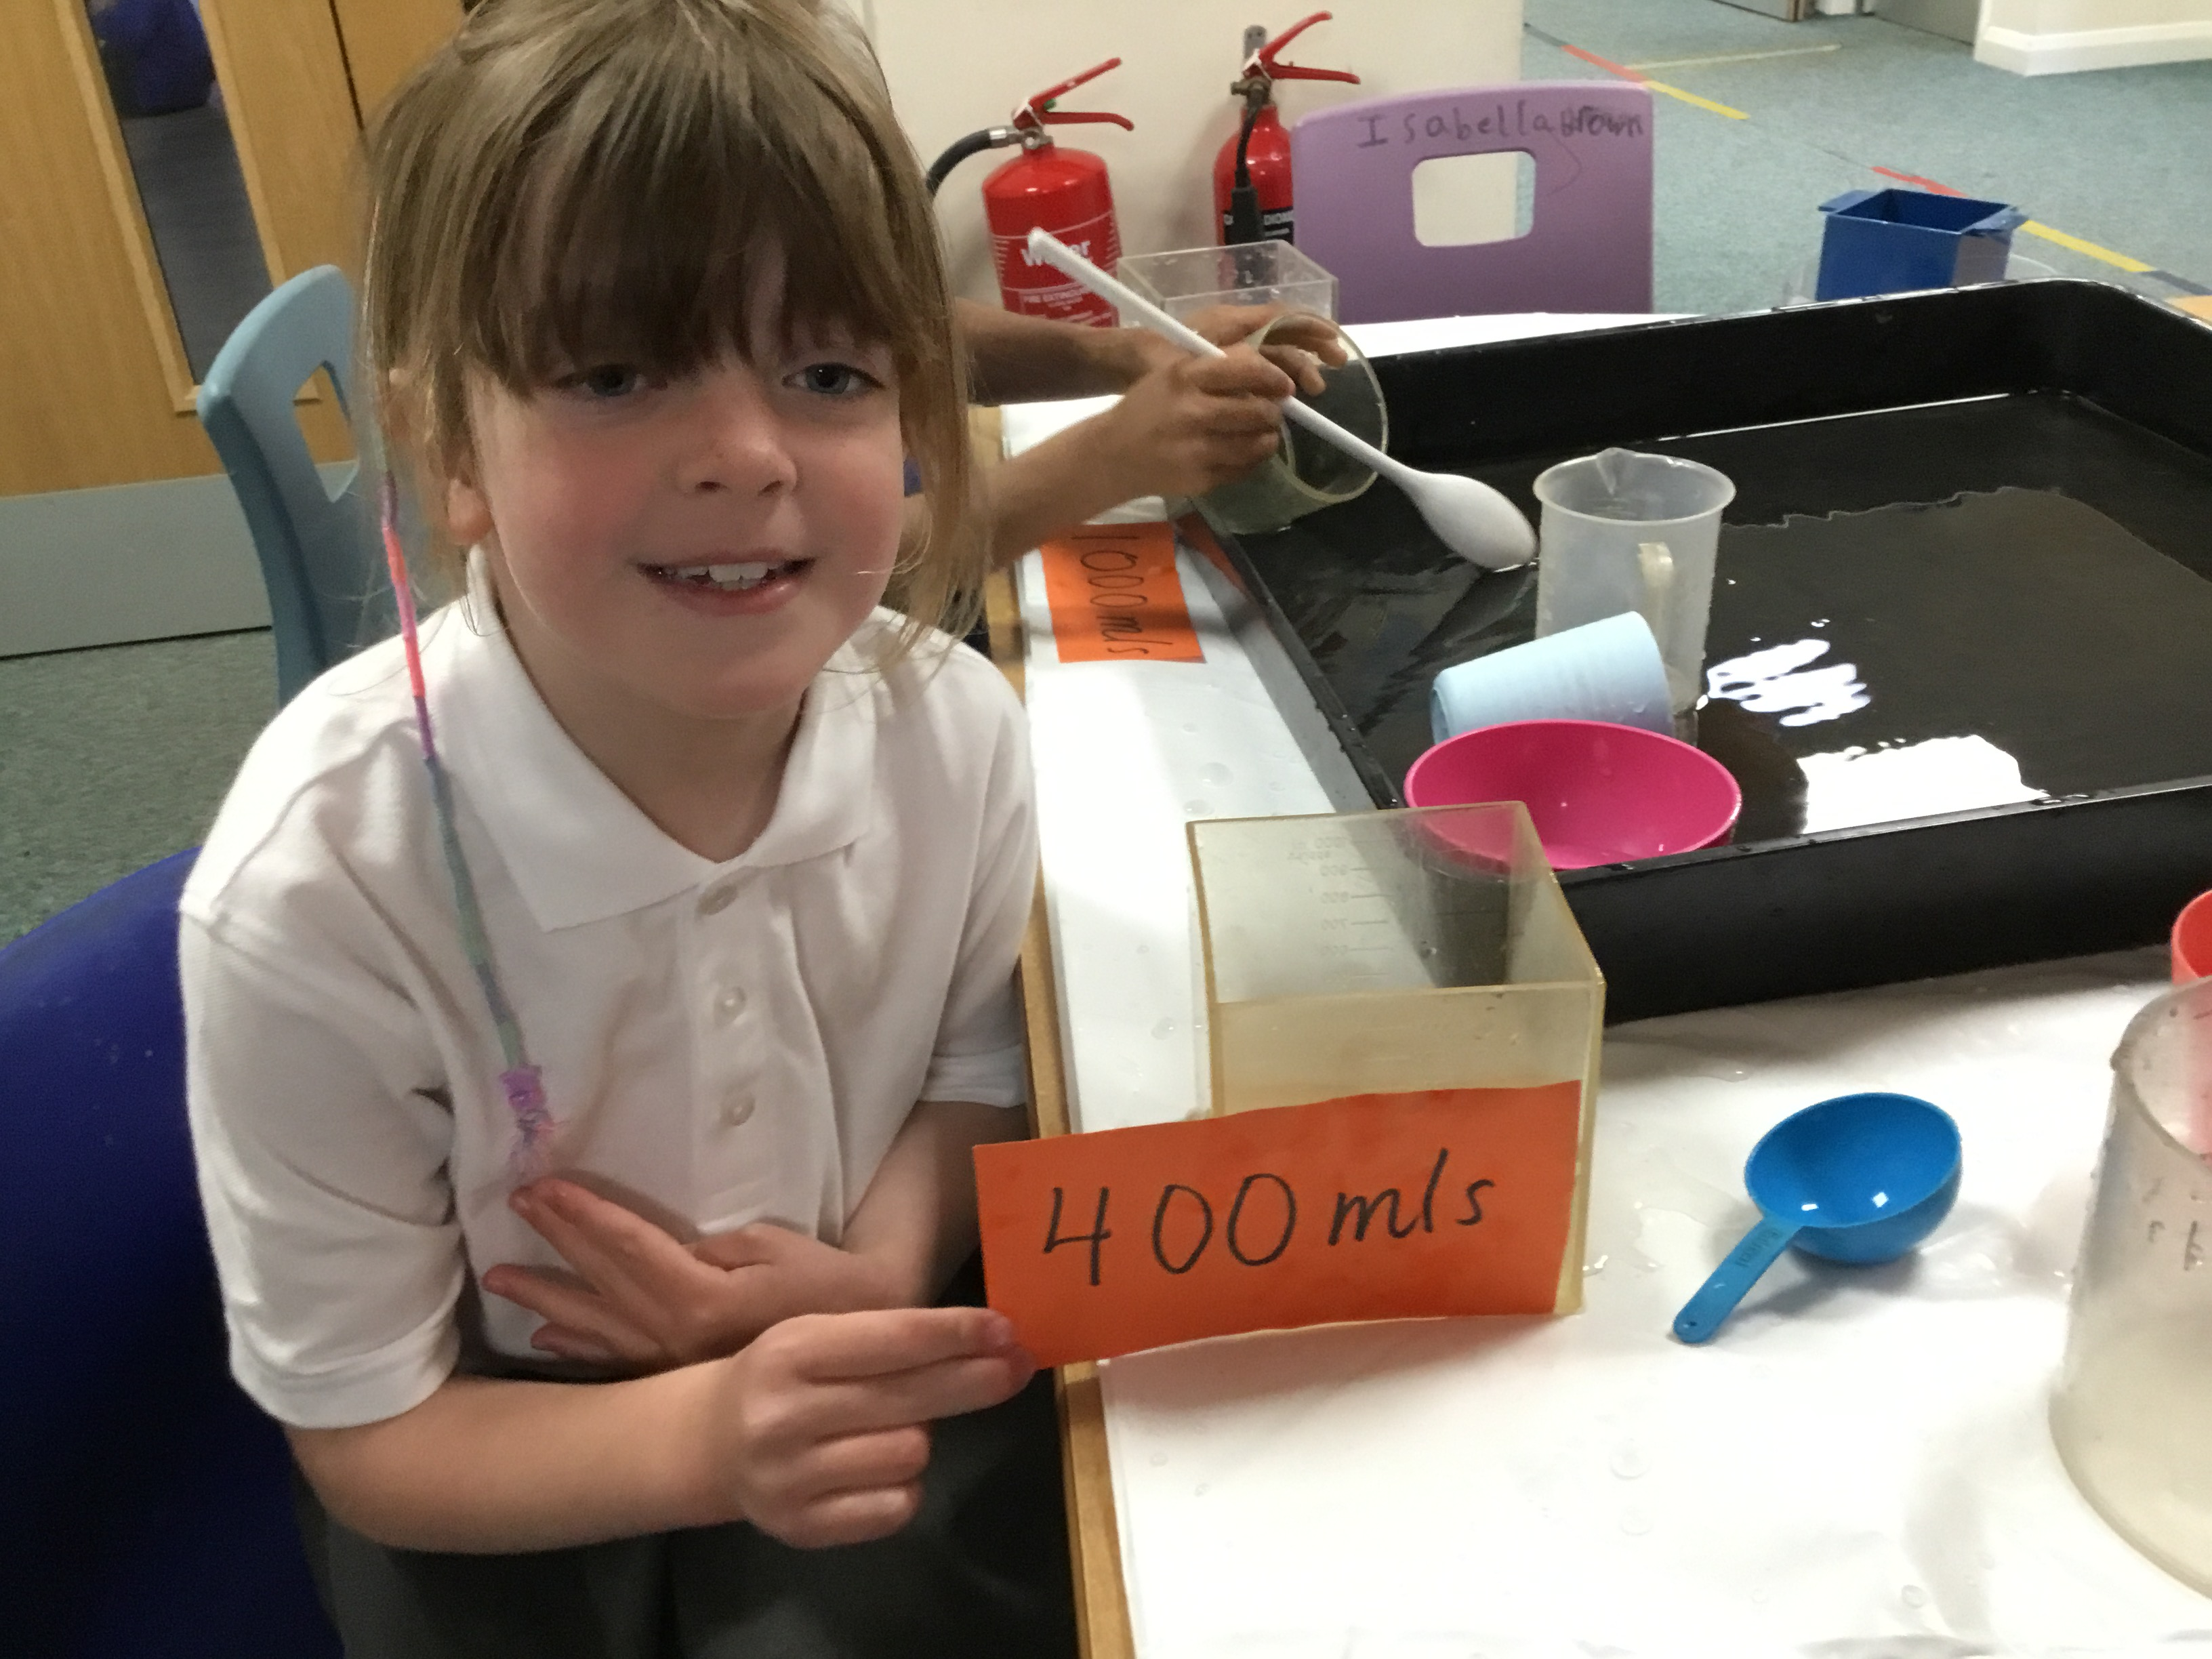
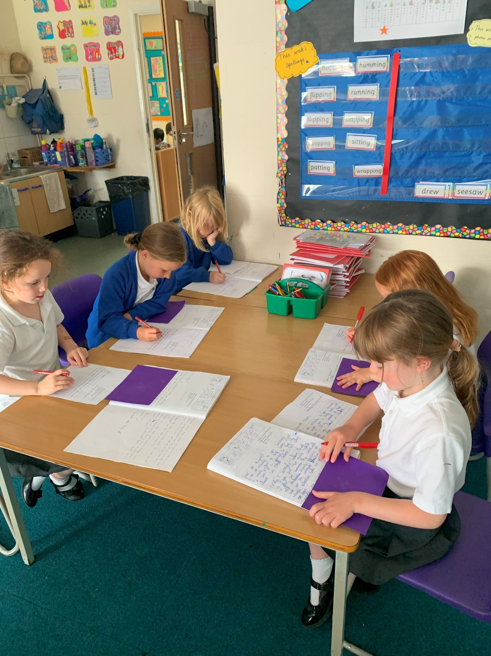
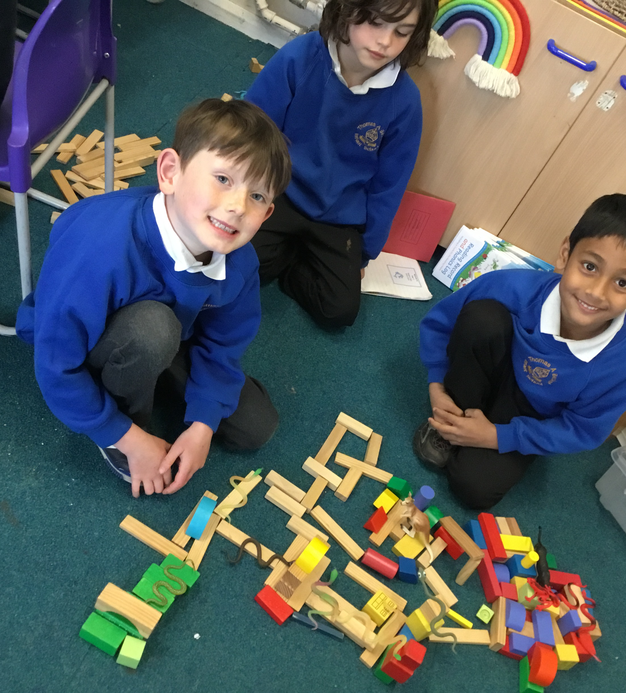
A Day in the life of a Year Two Child!
Morning:
Settling Activities: colour monster, activity at tables or a reading story on the carpet.
Phonics: Continuing on from Year 1
Snack and Playtime: Please ensure you send your child in with a water bottles every day, fruit is provided but your child can bring in a fruit or vegetable snack to have if they prefer.
Focus Subject: linked to theme such as writing, reading, foundation subjects (e.g. History/Art/Geography/DT) or Math’s.
Lunchtime: Children enjoy playtime at 12 and return for lunch either in their classroom or in the hall.
Afternoon: Continuous Provision
This is a time children develop their independent learning skills, achieve National Curriculum outcomes and embed prior learning through linked provision in our Rainbow Challenges and COOL Time activities. Teachers and TAs will lead activities, have reading groups or interventions. Sometimes we will have Assemblies or PE.

Slide 4
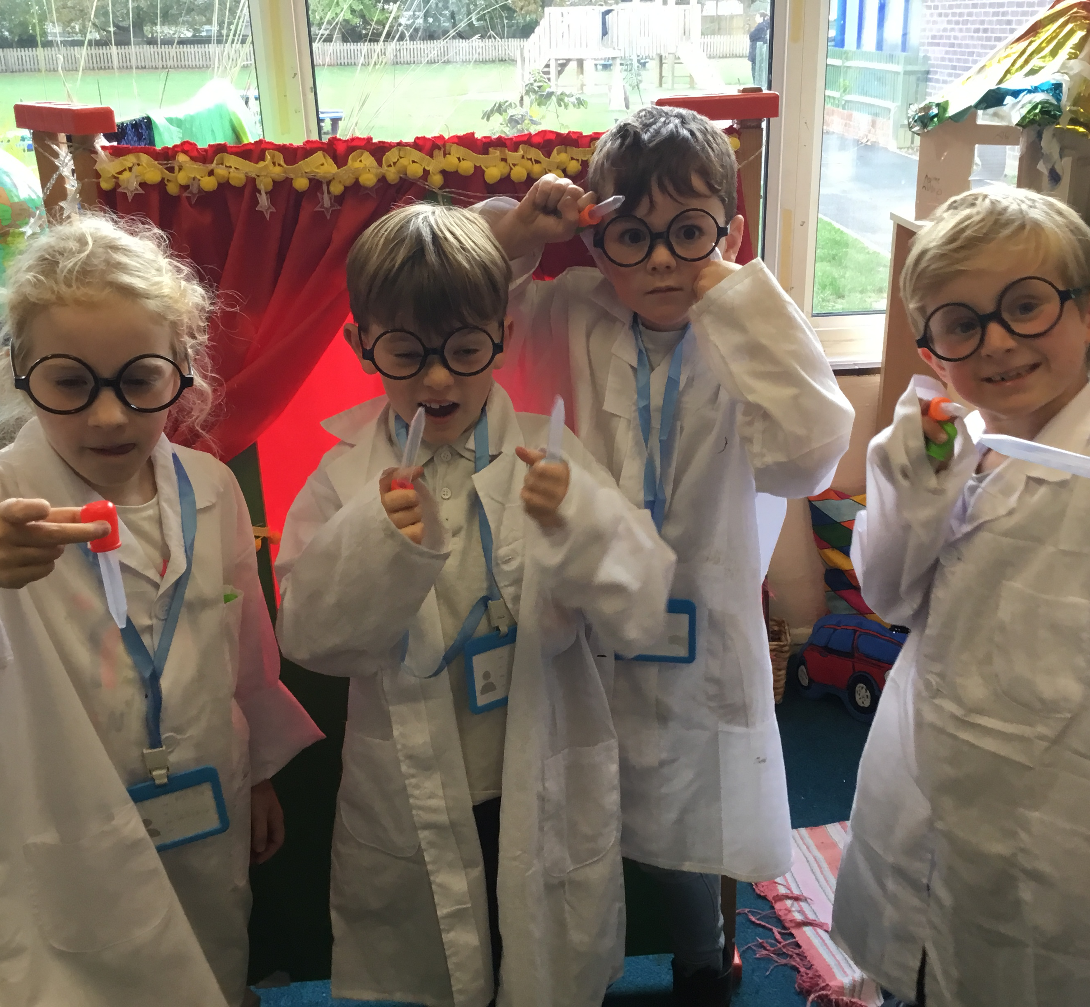
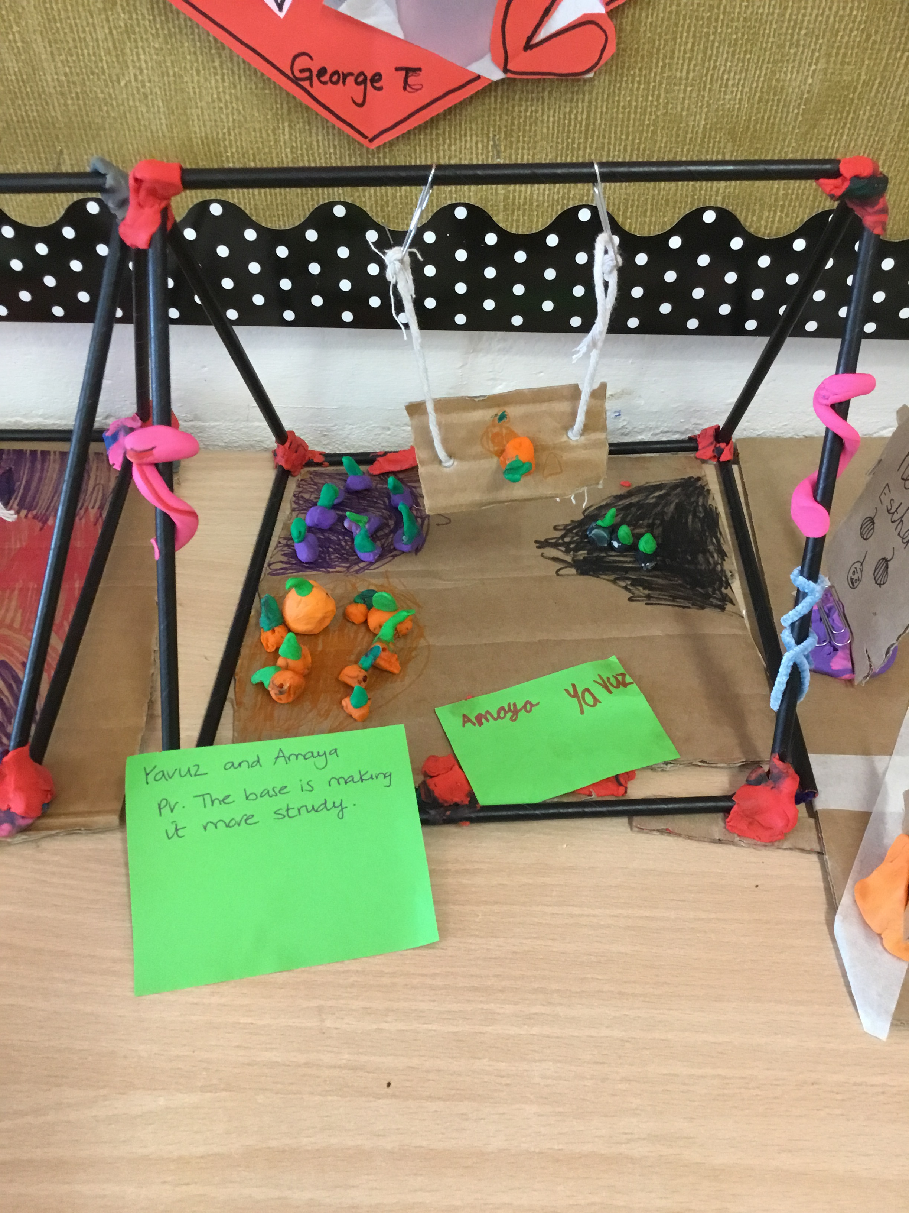
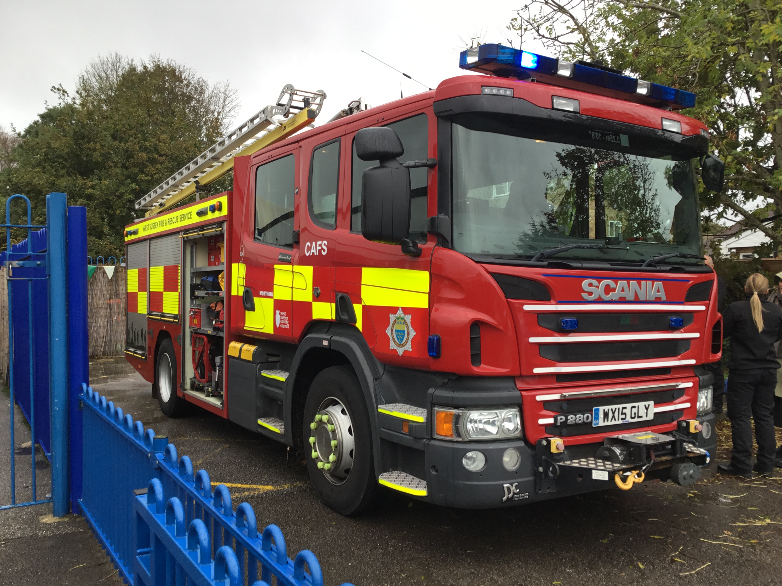
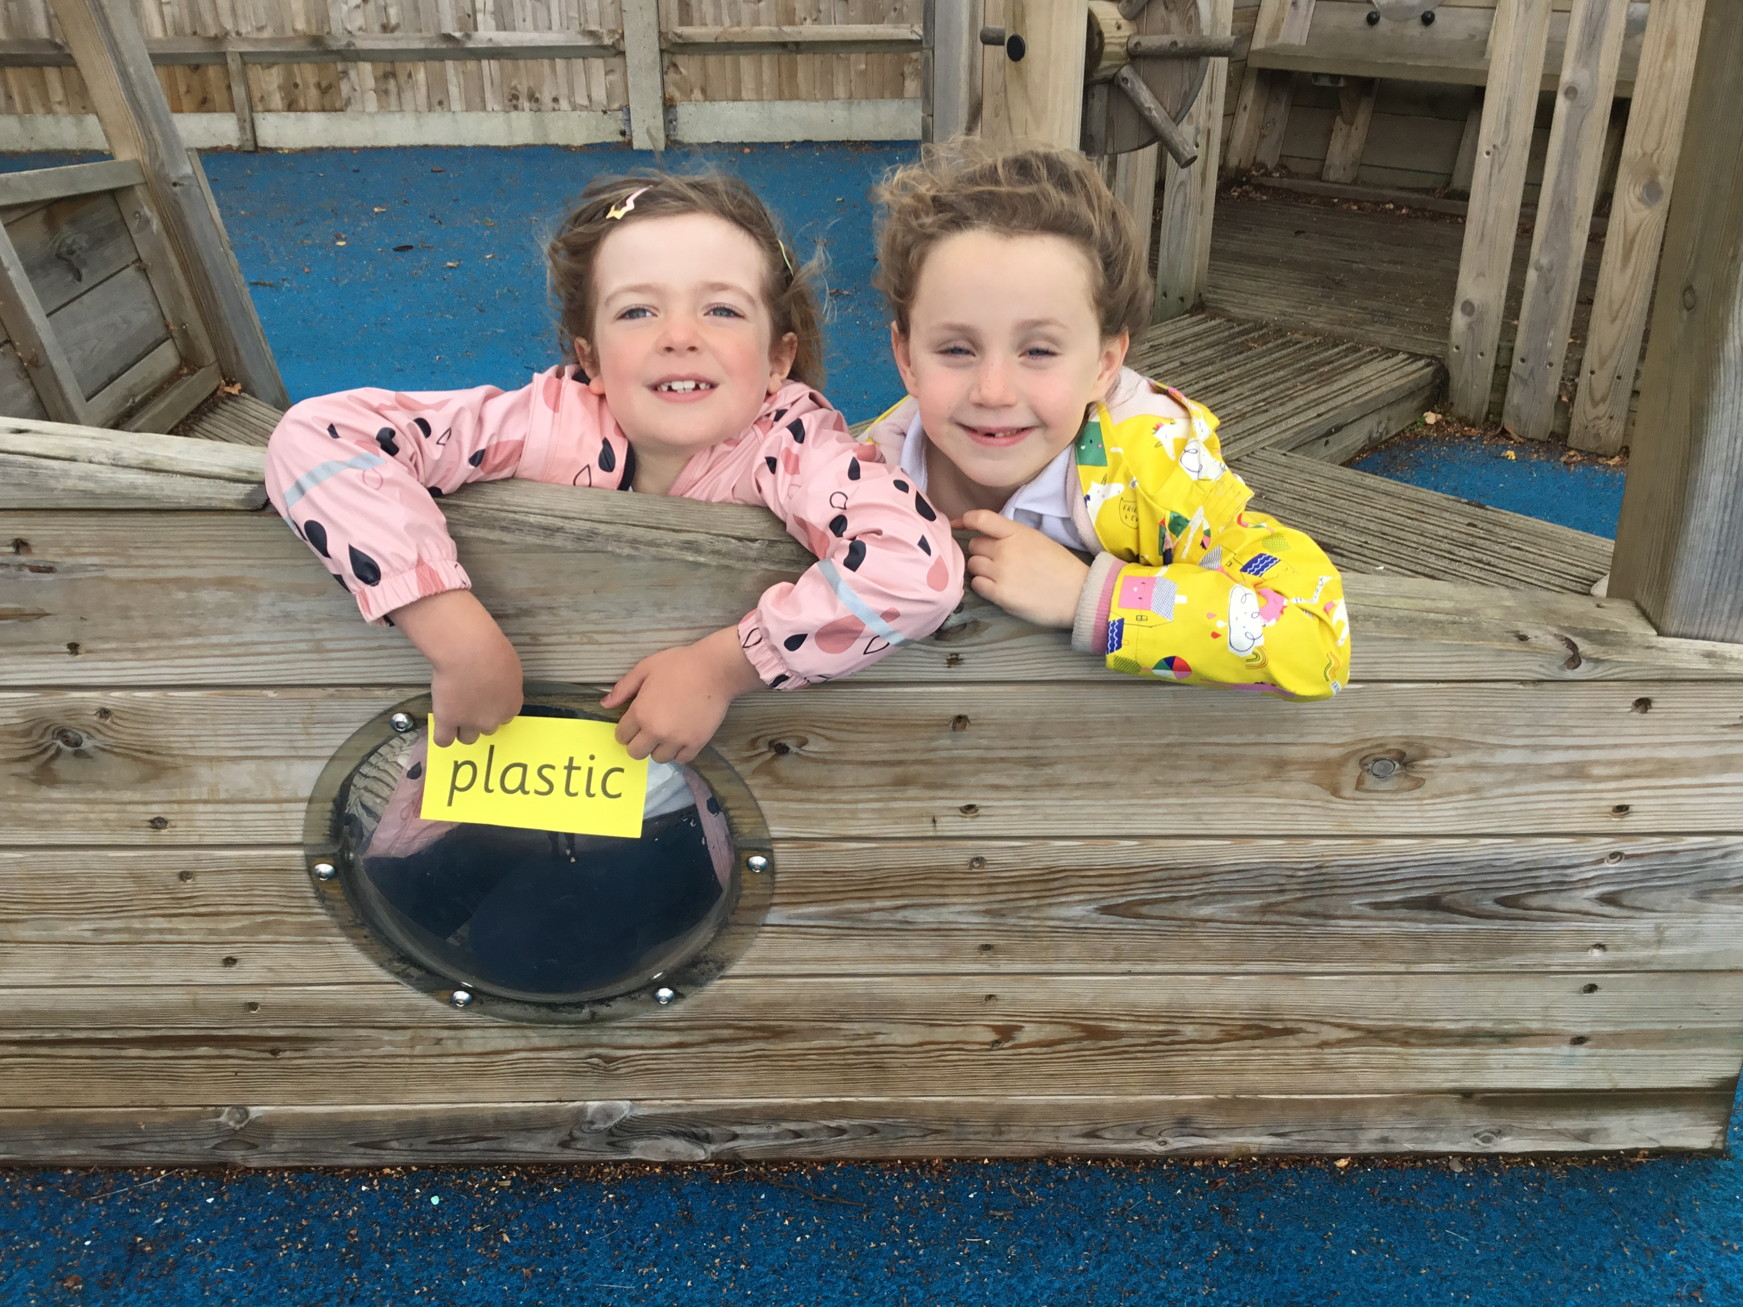
Autumn Term Themes!
We have whole school themes but within each year group there is a different learning focus according to our children’s progression of skills.
The themes we will cover this term are:
RSHE focus and settling in…
Let’s Play
First week: RSHE and settling in. Science, DT and English focus of fair testing and designing, building and assessment. October we will celebrate Black History.
Let’s Celebrate RSHE focus learning about heroes, Remembrance Day, different religious celebrations, Diwali and their values. English focus learning how to read and write different types of poetry. Finally with a week dedicated to Christmas fun!

Slide 5
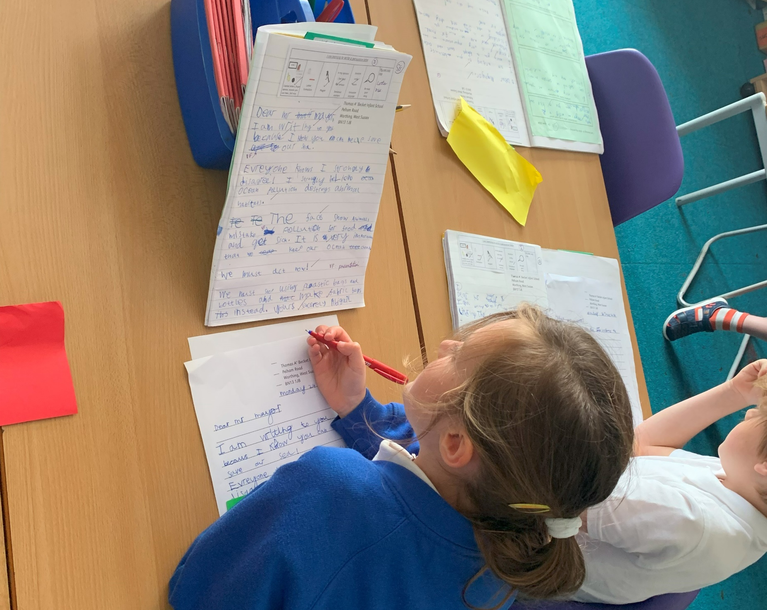
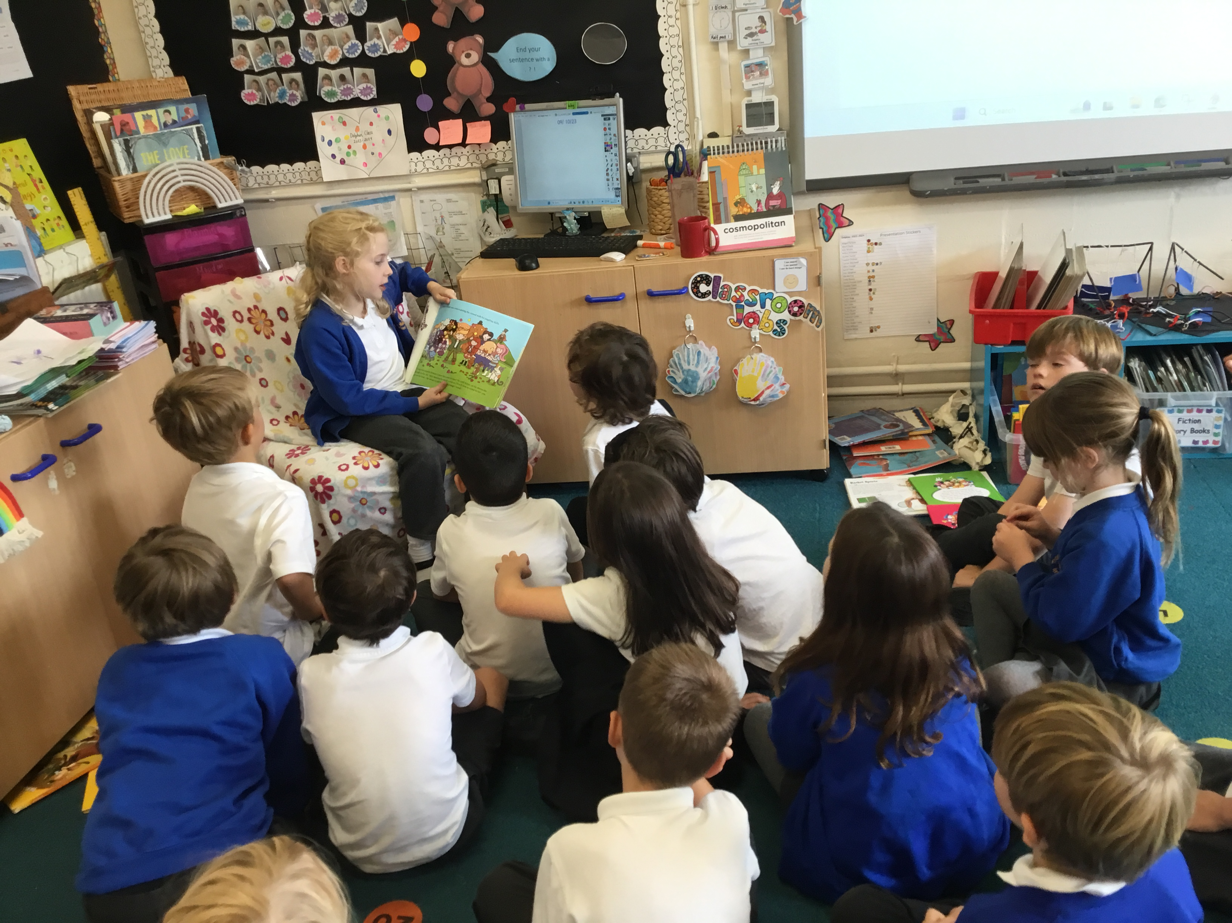
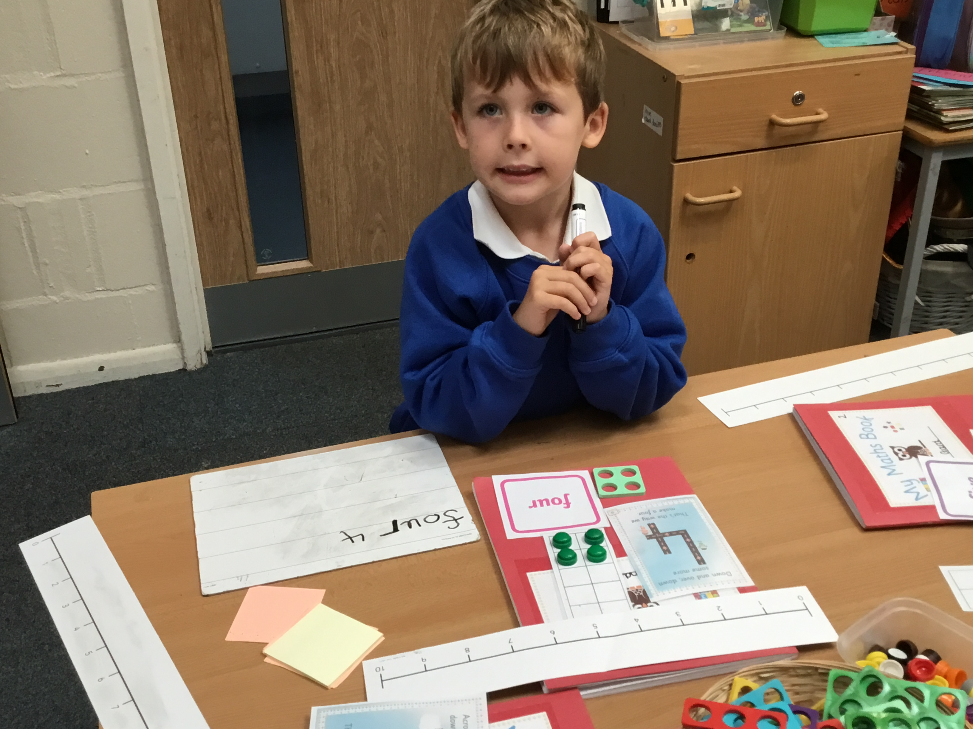
End of Autumn Term Expectations
Writing: To have consolidated their abilities to write a series of coherent sentences using a capital letter, finger space, varied punctuation and a conjunction. The children will have begun to use noun phrases and adverbs.
Reading: To know all the 44 phonemes and apply them to their reading with increasing fluency. To be able to decode longer words. To be able to discuss what they have read with some detail. Maths: To recognise, write and order number to 100. To understand the place value of numbers with two digits. To be able to begin add and subtract using the strategy of crossing and exchanging with 10.

Slide 6
How can you support your child?
Each Friday your child will choose 2 or 3 books to take home for the following week to read. Each book will be colour coded to match your child’s phonic ability.
Each half term new books will be available through Collins ebooks for your child to access based on their reading ability. There will be a password given by your class teacher. Some of these books correspond to books being read in our reading sessions.
Please read with your child for 10 minutes each day.
Spellings – we will be sending home spellings for the children to learn every Friday. These words will cover the Year 2 CEWs and words from their weekly spelling rules. Additionally, as in Year One, words will be on Spelling Shed. Your child’s login is glued into your child’s spelling book.

Slide 7
“Incredibles” Reading Challenge
In Year 2 we have a The “Incredibles Reading Challenge”.
1 read = 10 minutes.
Your child will be rewarded at various stages in their reading, special awards will be given for:
50 reads- a certificate, 100 reads- Pencil, 200 reads- choose your own book!
When recording in the reading diary you don’t have to write lots, you can just put the date, the book read and the number of pages.

