Slide 1
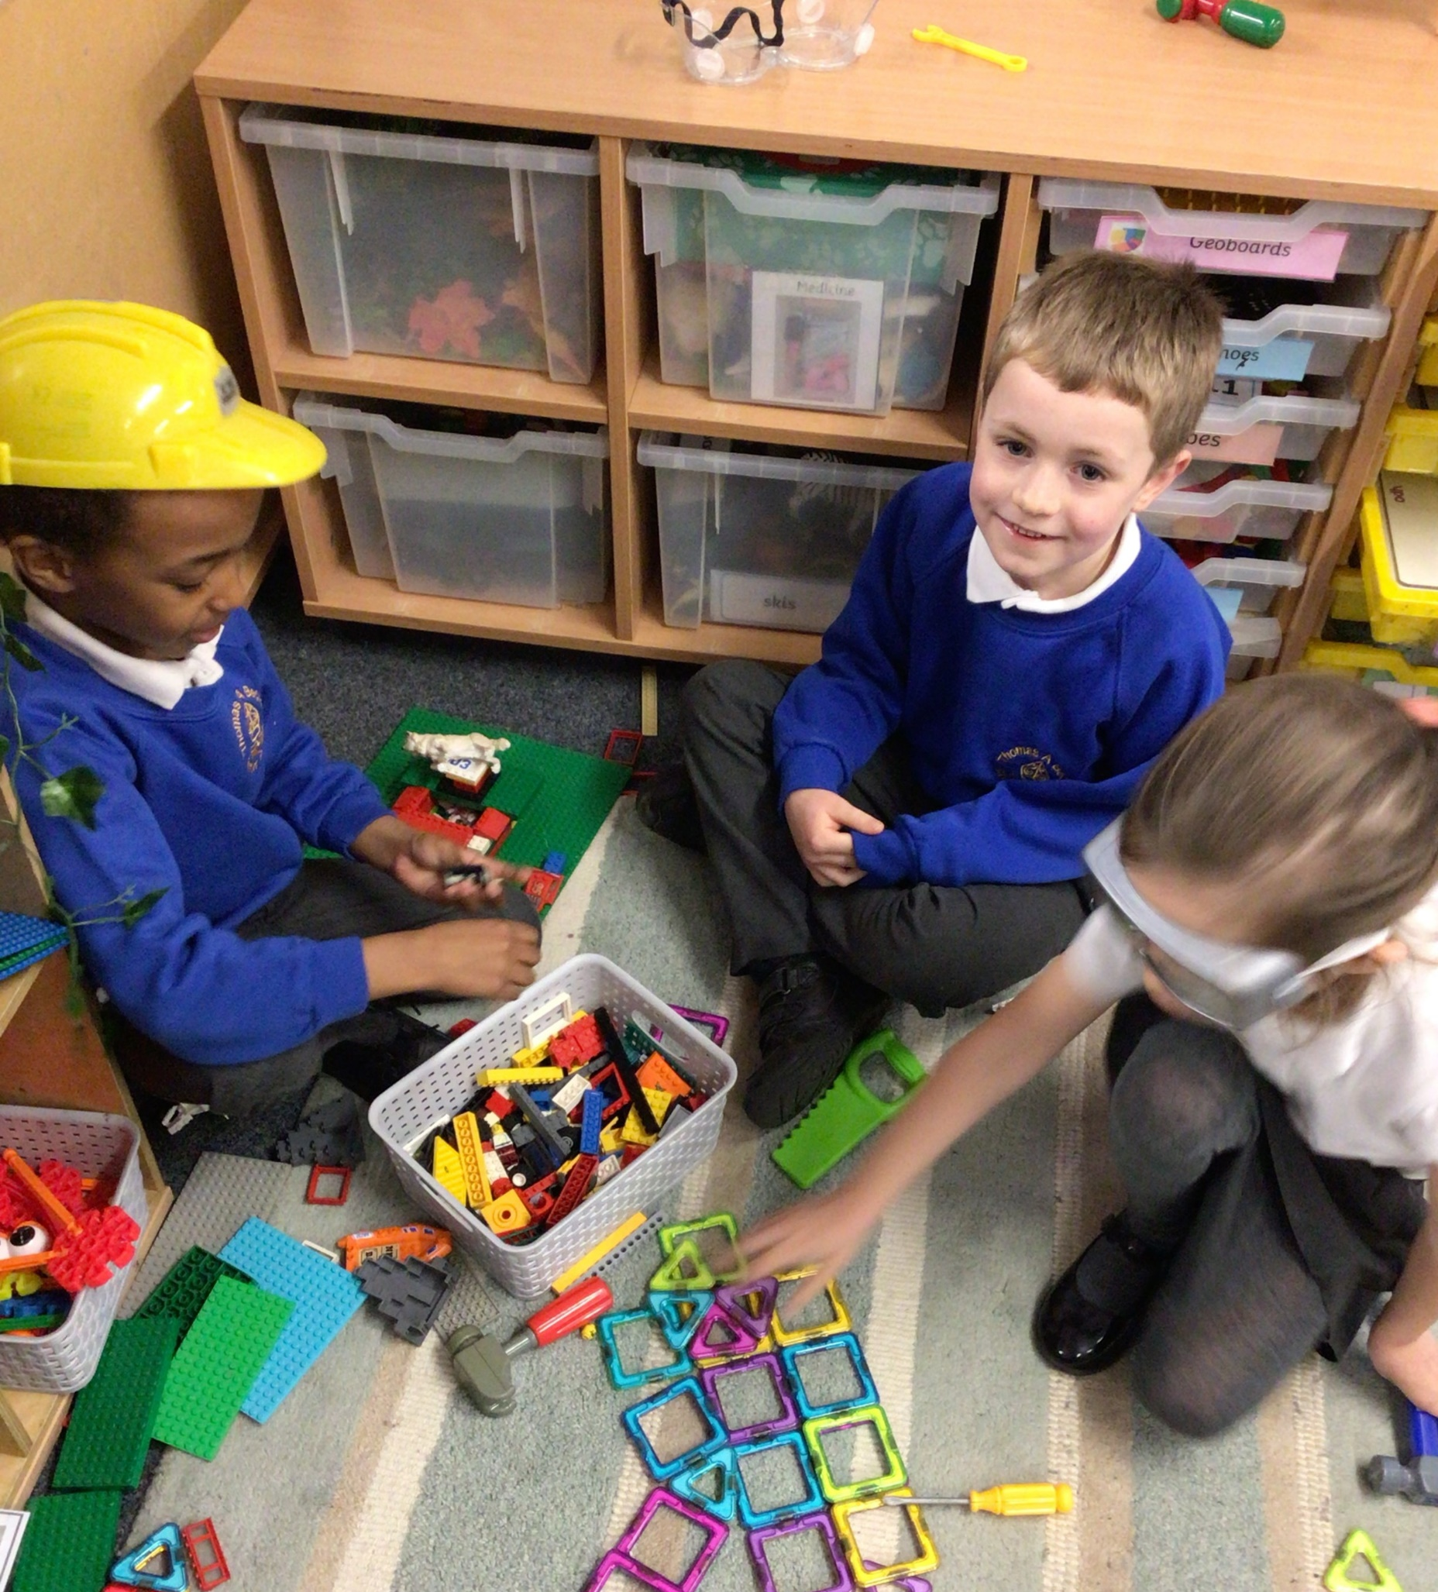
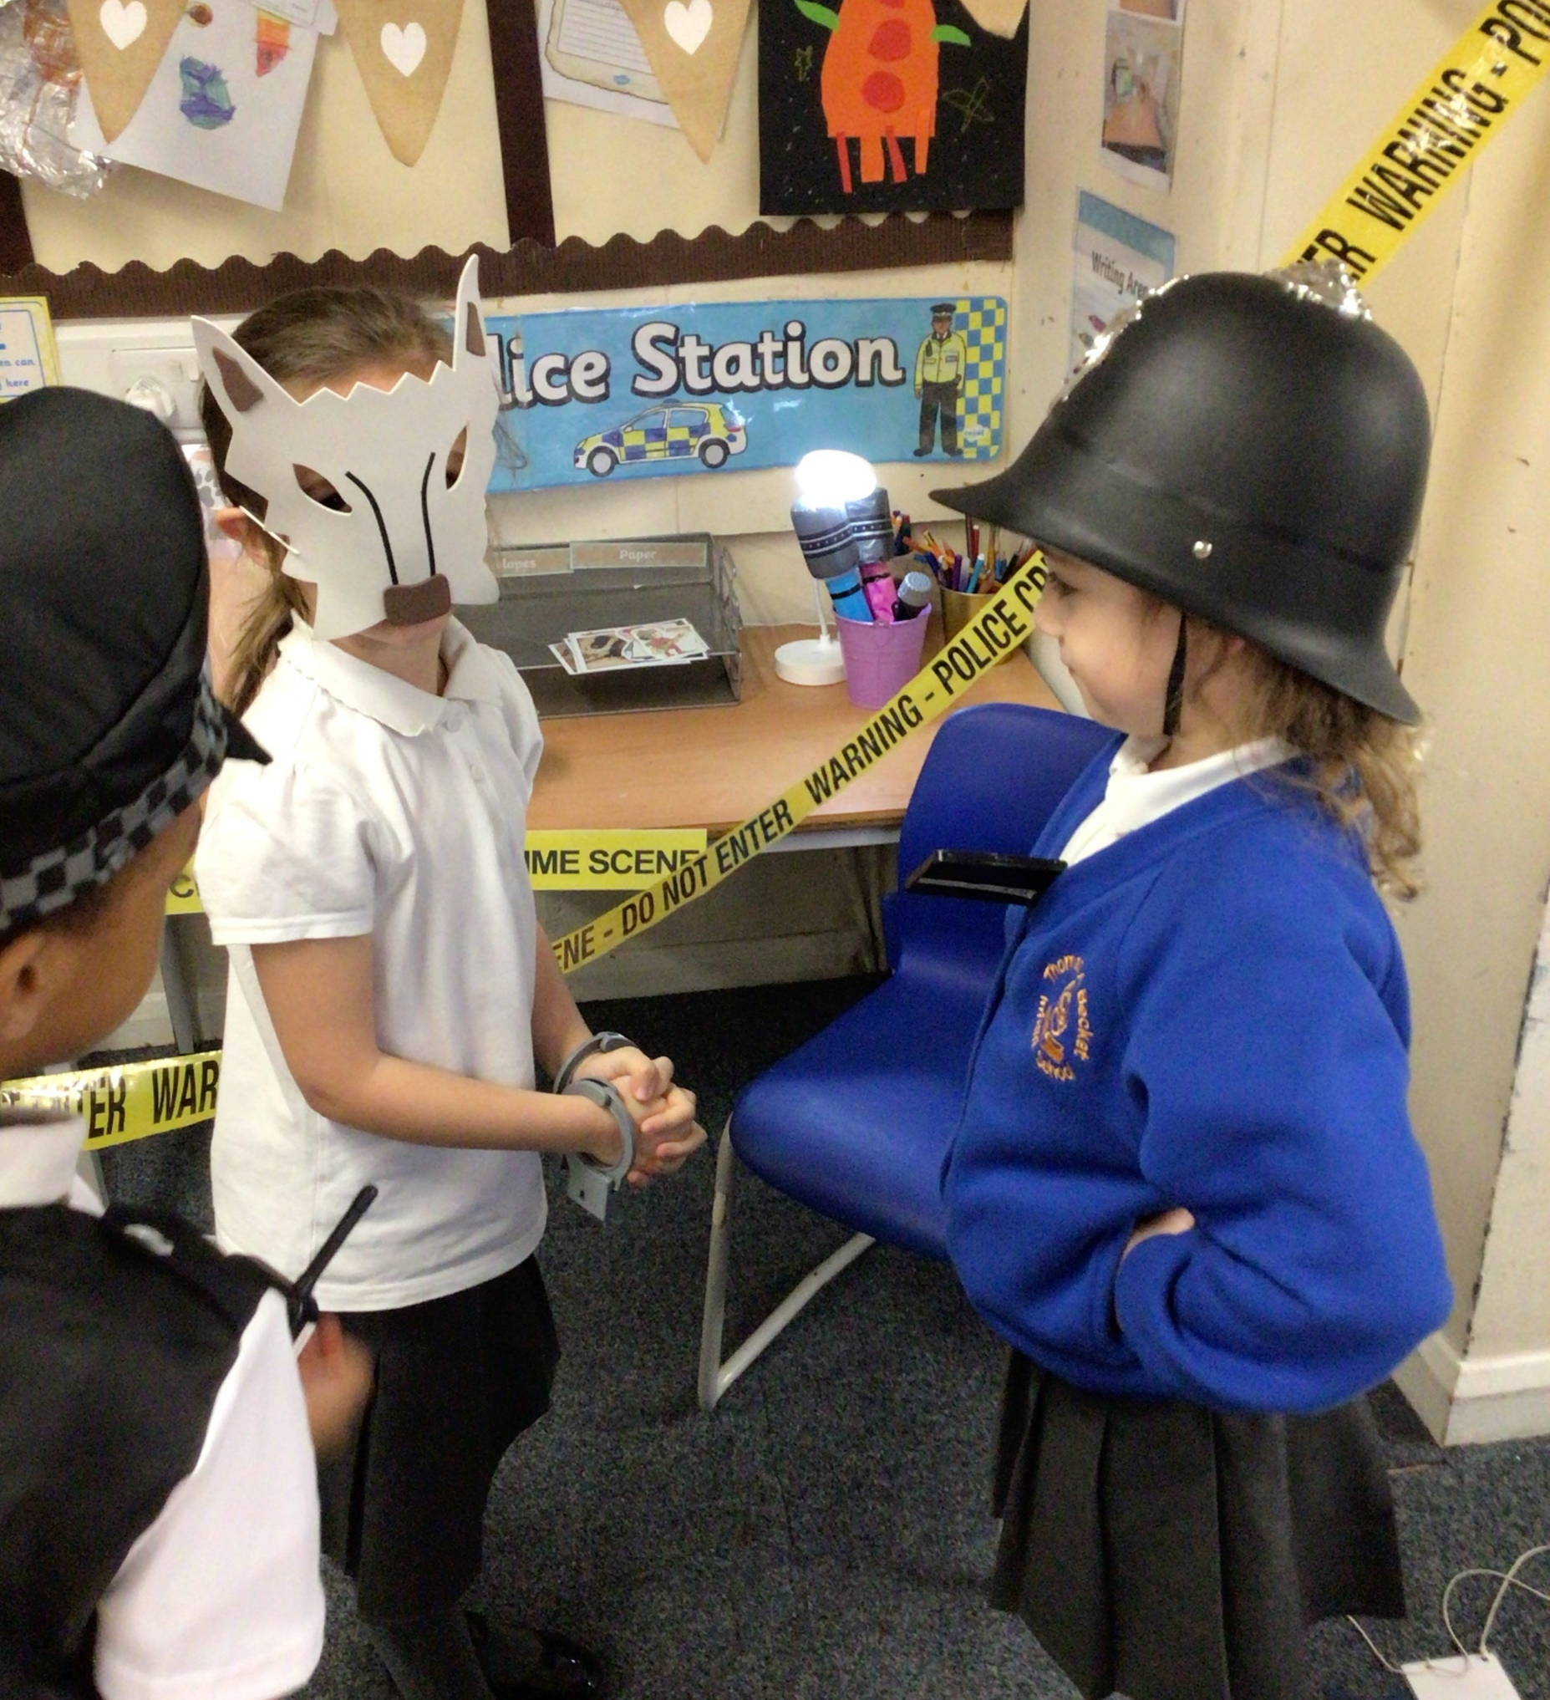
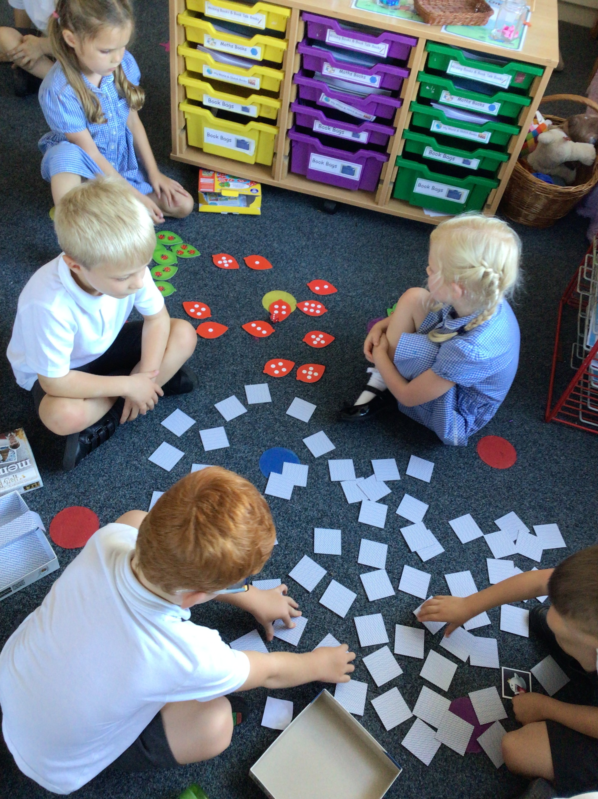
Welcome to Year One!

Slide 2
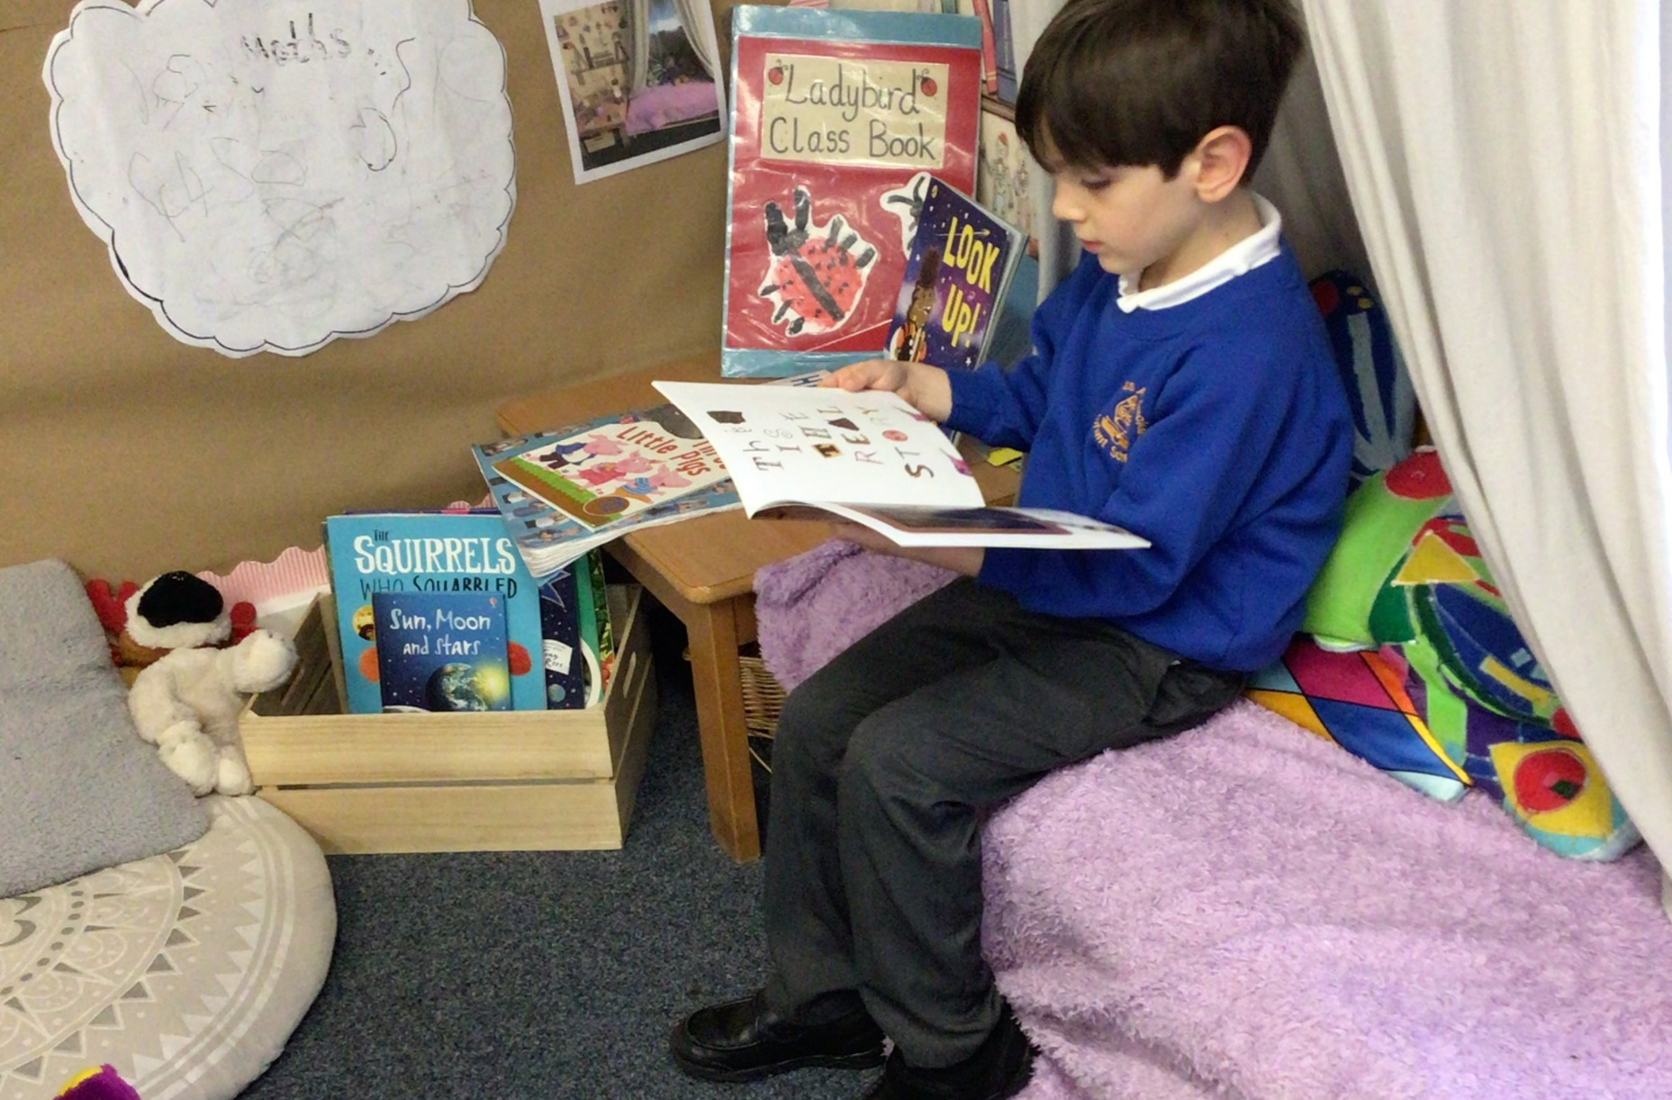
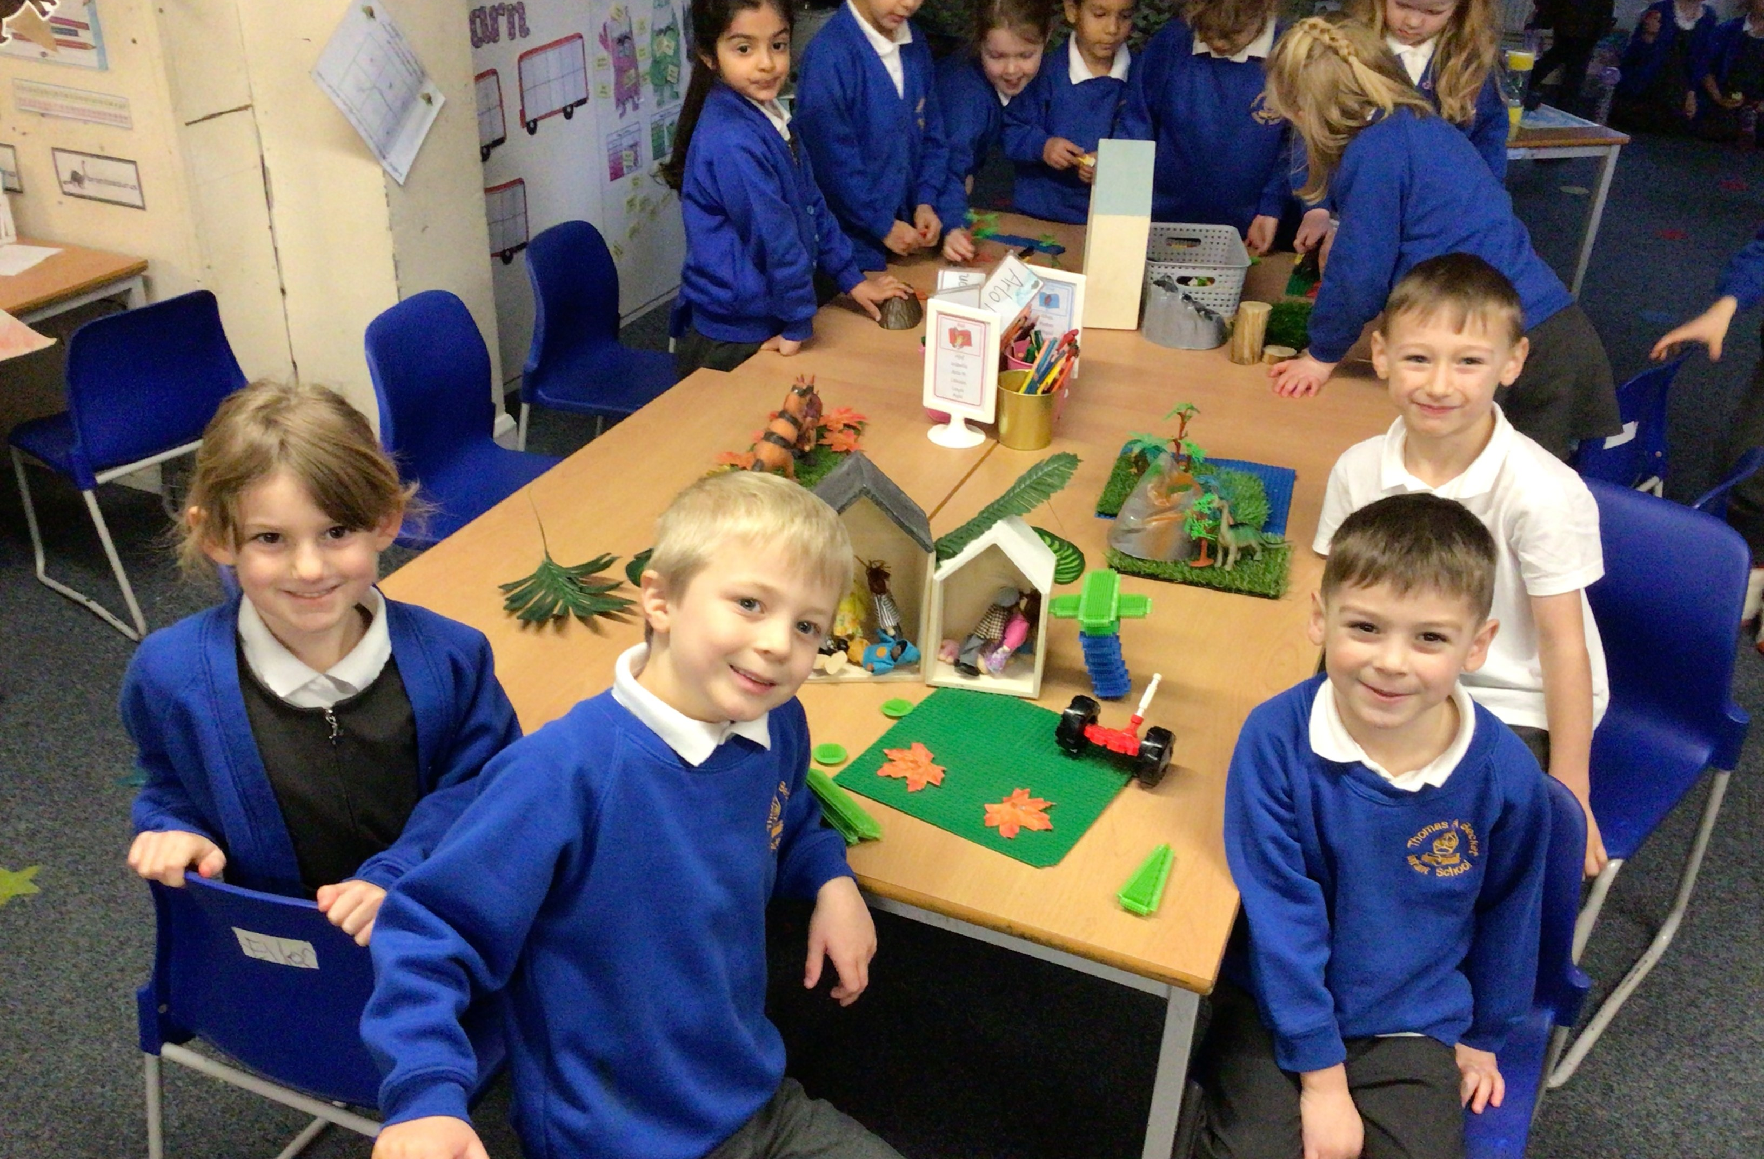
Transition from EYFS to Year 1
As part of the transition between Early Years and Year 1, we make sure that as many aspects of our classroom are similar to Early Years.
Throughout the week the children will have Continuous Provision, which we call COOL Time (Continue Our Own Learning Time).
In our classrooms the children will have access to Small World Area, Construction Area, Role Play Area, Sand/Water or Malleable Area.
The children also have access to our Outdoor Area.

Slide 3
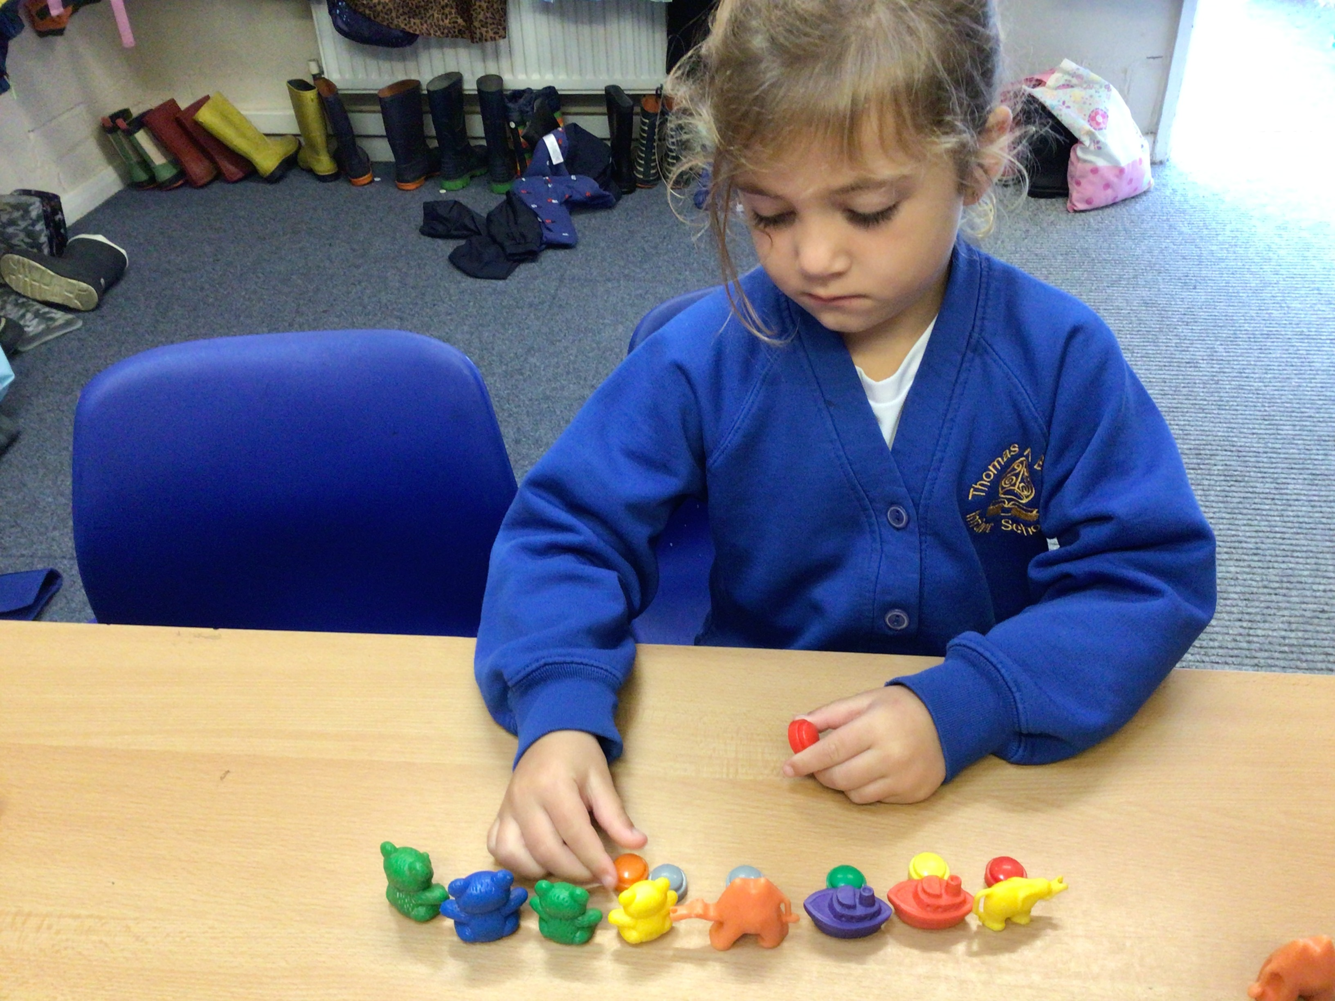
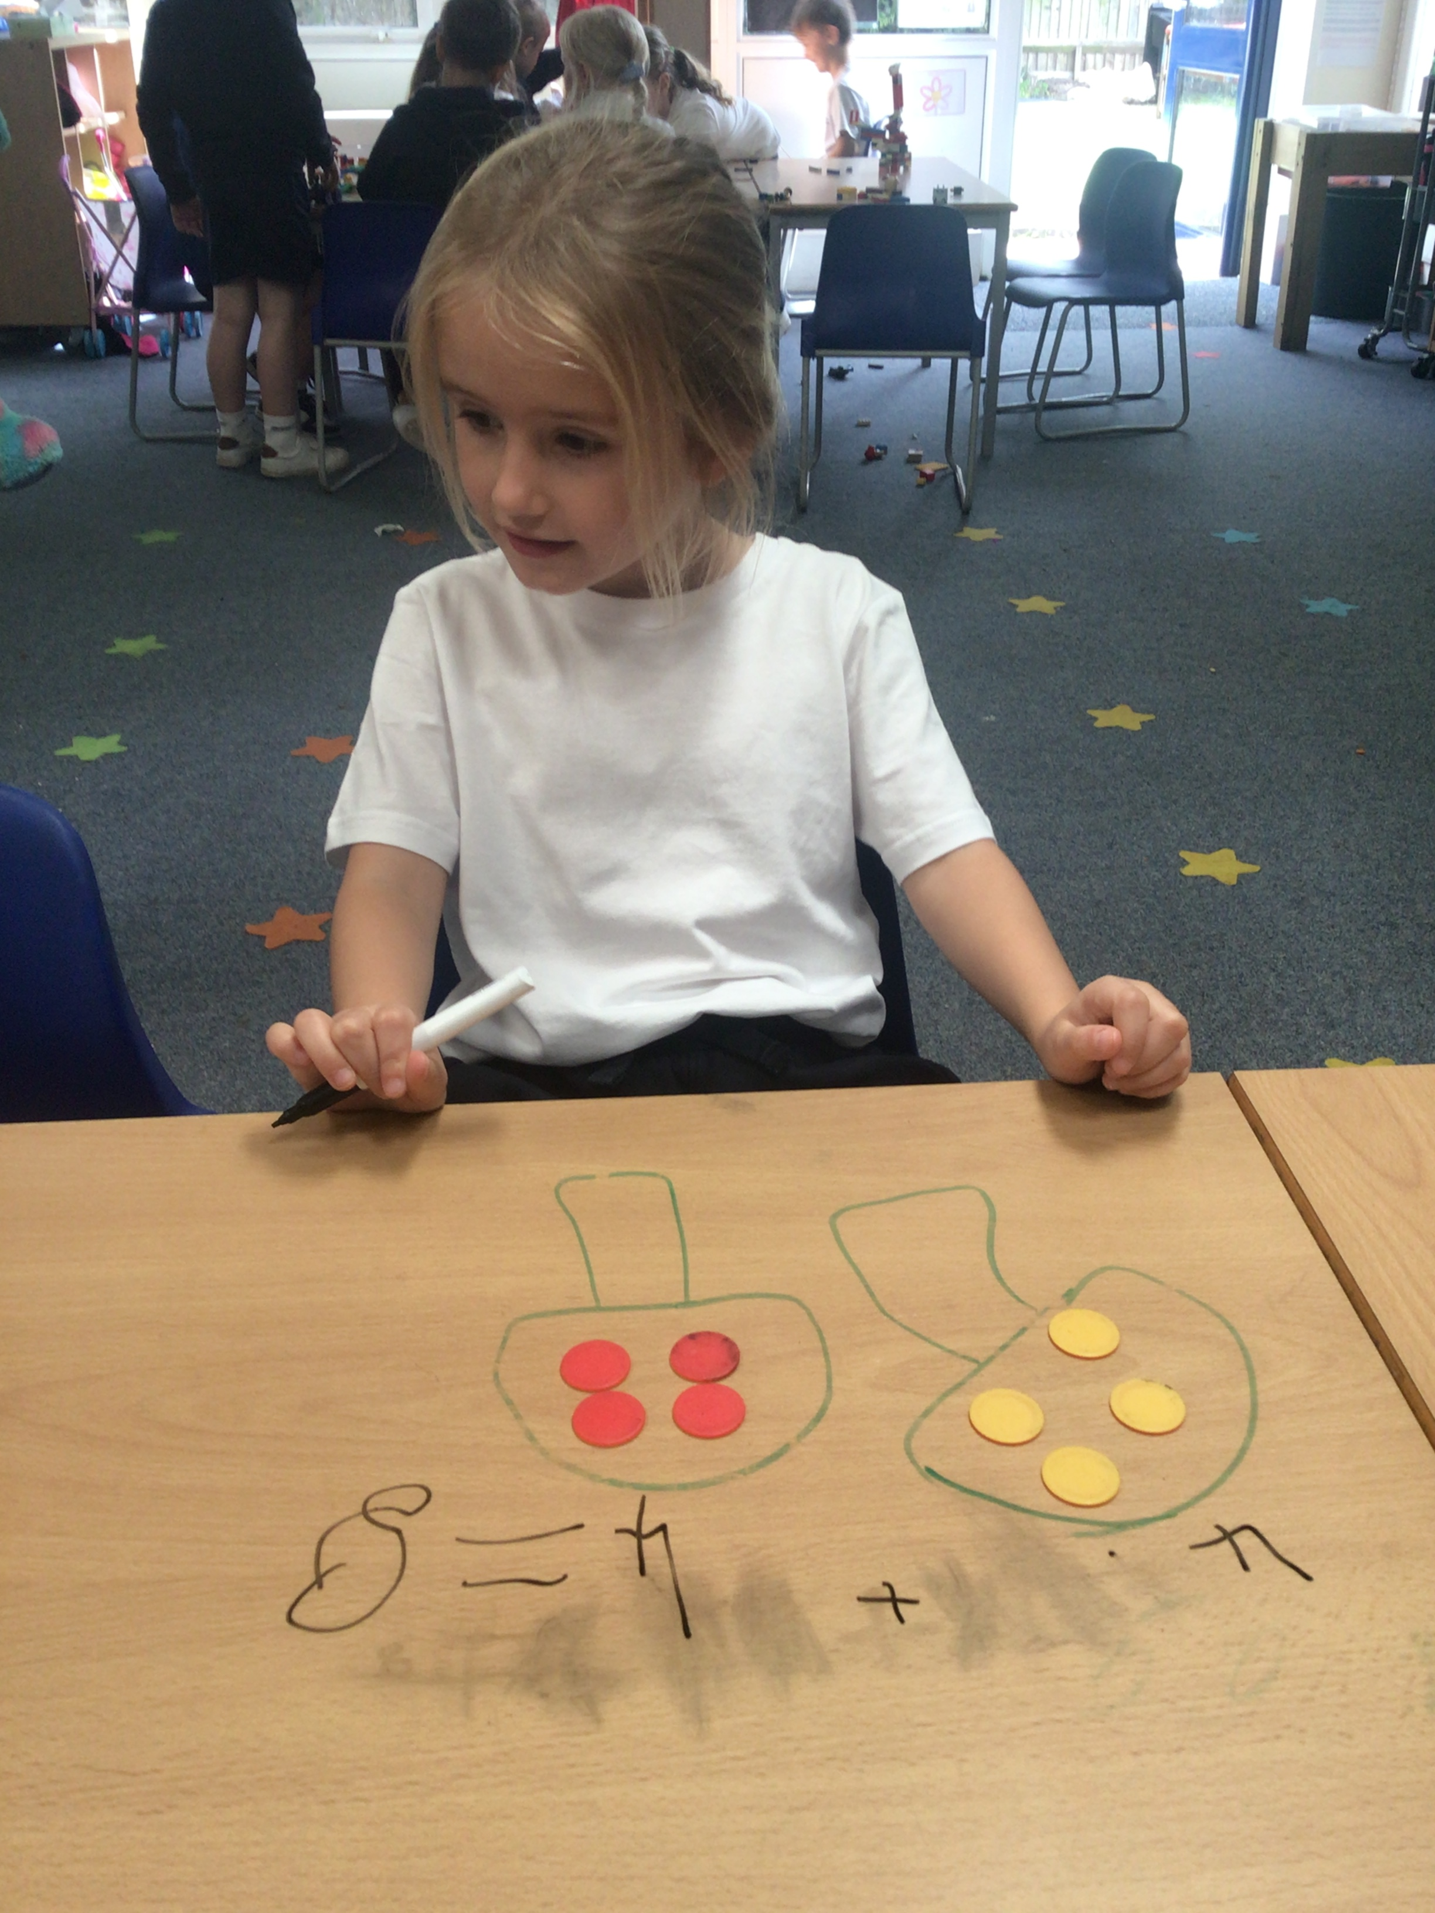
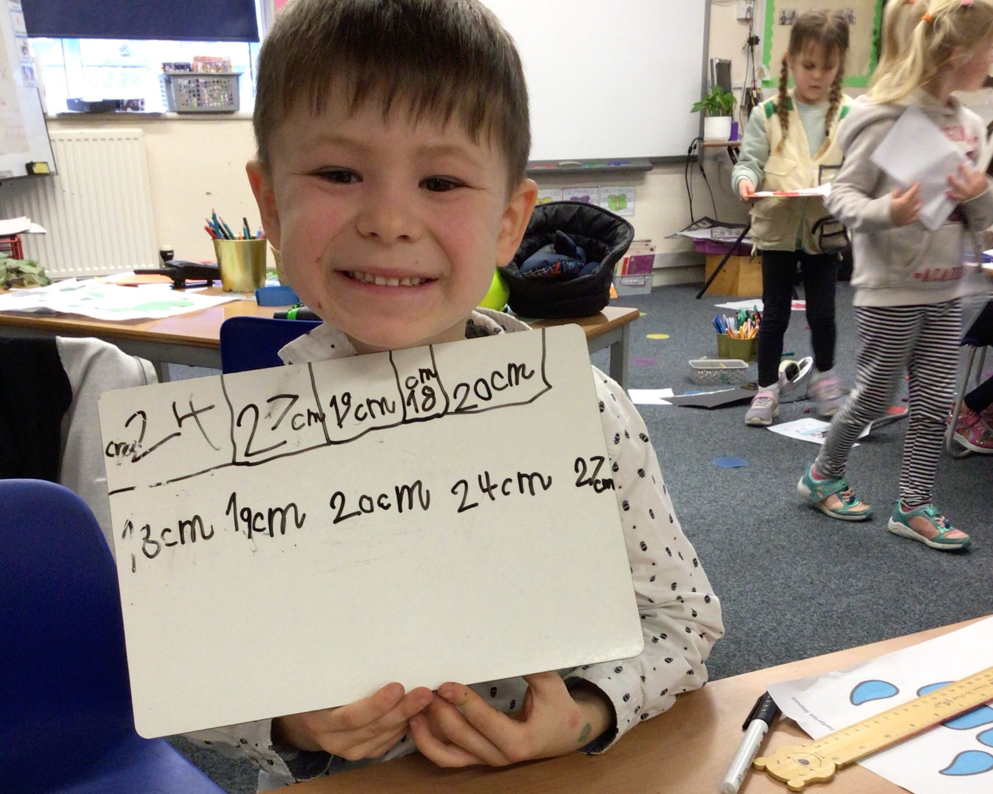
A Day in the life of a Year One Child!
In the Morning:
Settling Activities: Colour monster, activity at tables or on the carpet.
Phonics and handwriting: During the Autumn Term we will invite parents in to explain Phonics in more detail.
Linked Provision: This is when the class teacher will target your child’s learning. Reception teacher's have worked closely with us to identify your children’s needs and ways to move them on in their learning.
Snack and Playtime: Please ensure you send your child in with a water bottles every day, fruit is provided but your child can bring in a fruit or vegetable snack to have if they prefer.
COOL Time: Children select from a range of activities linked to the theme and can also access different continuous provision areas. During this time adults will work with small groups of children to complete focus writing activities, group reading or 1:1 reading.

Slide 4
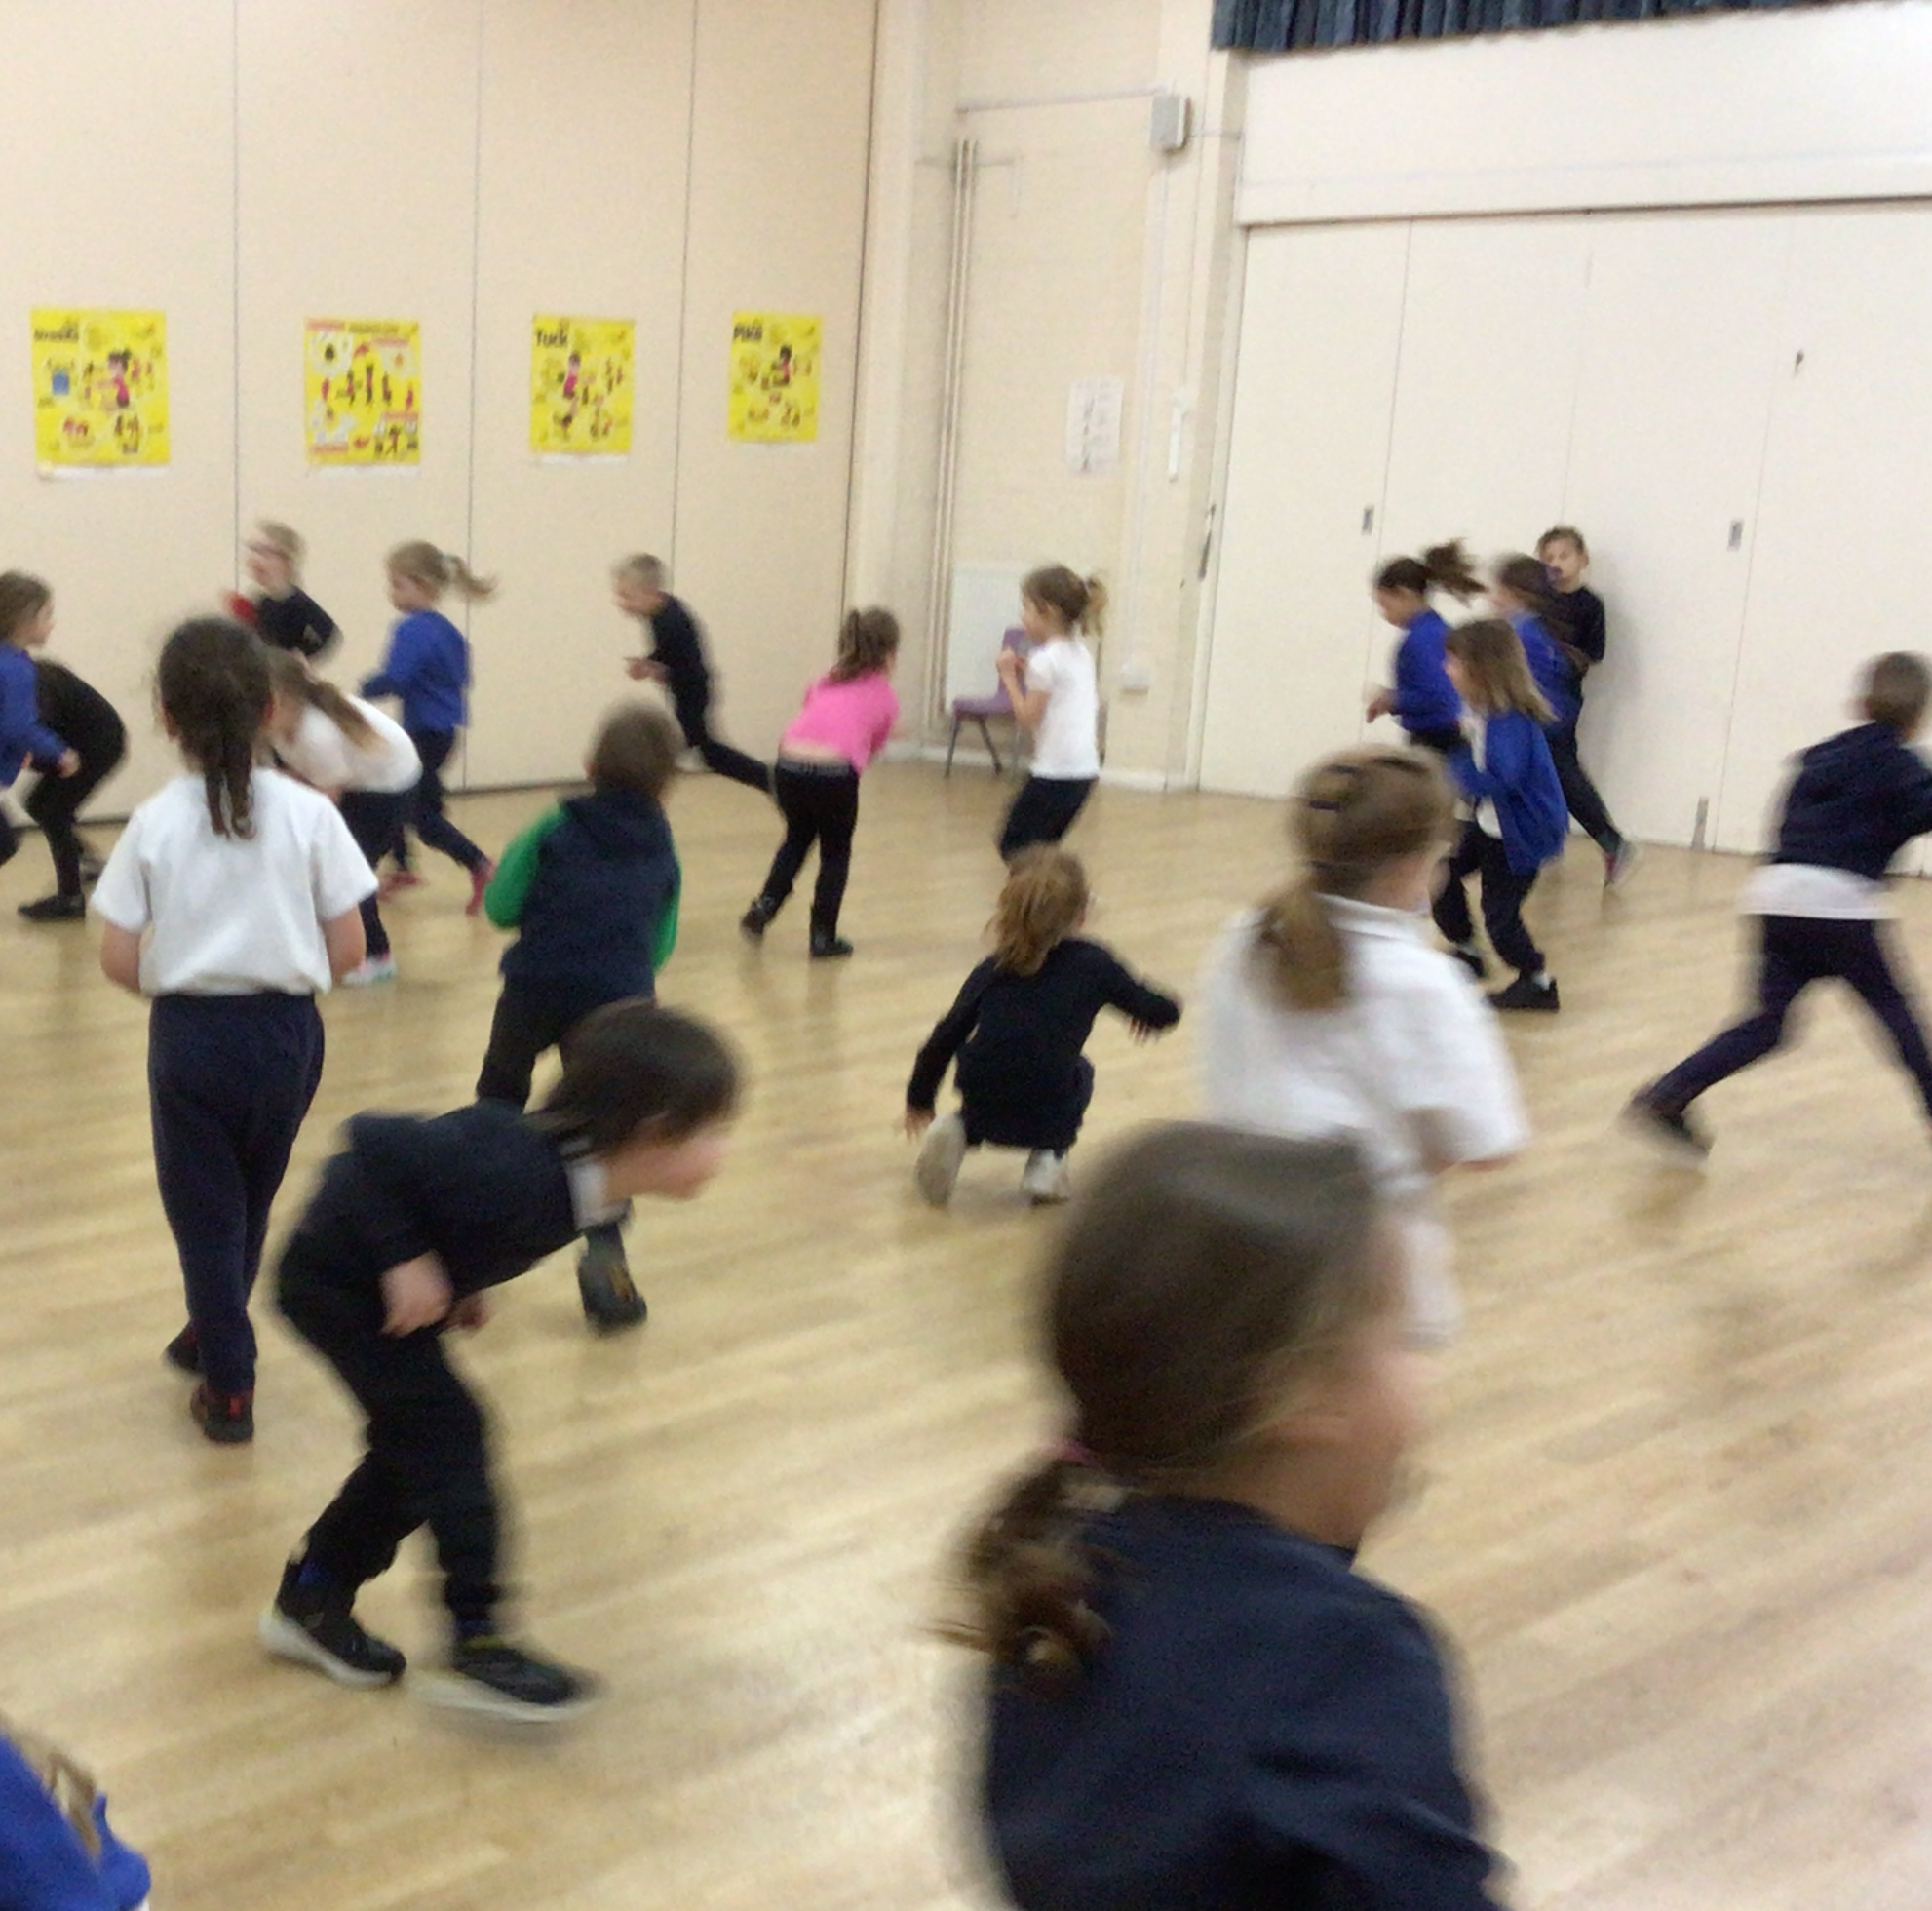
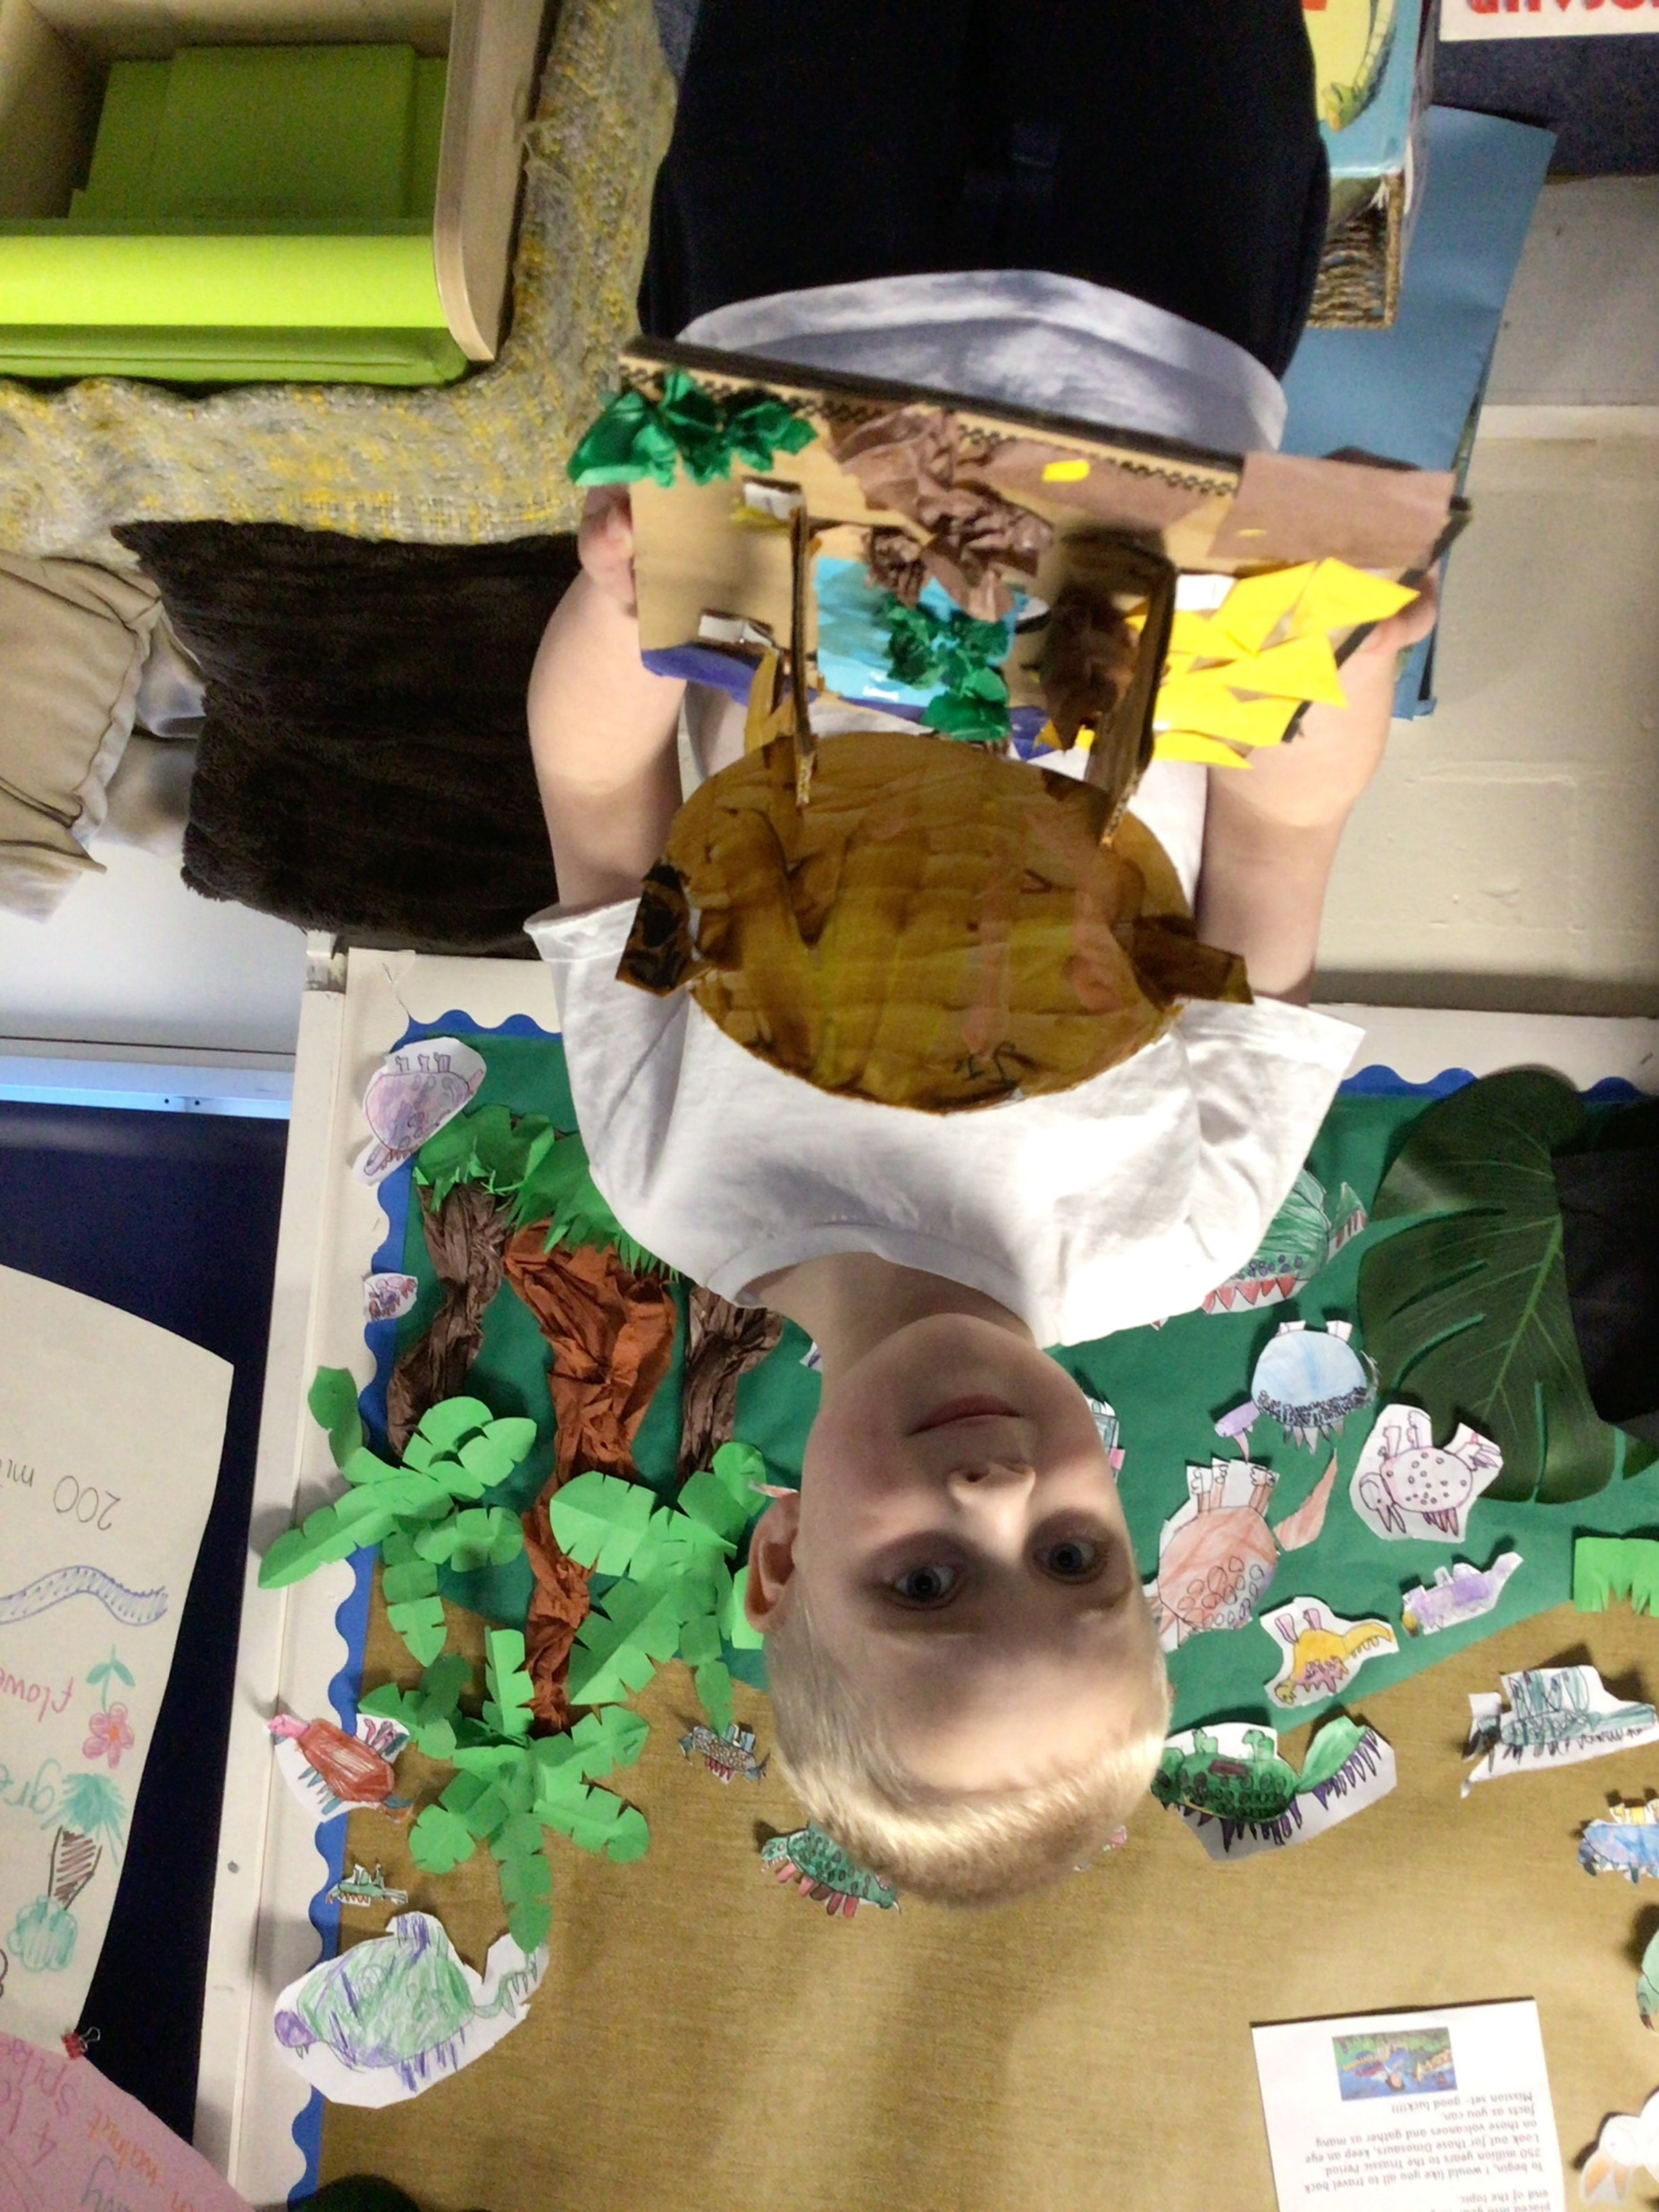
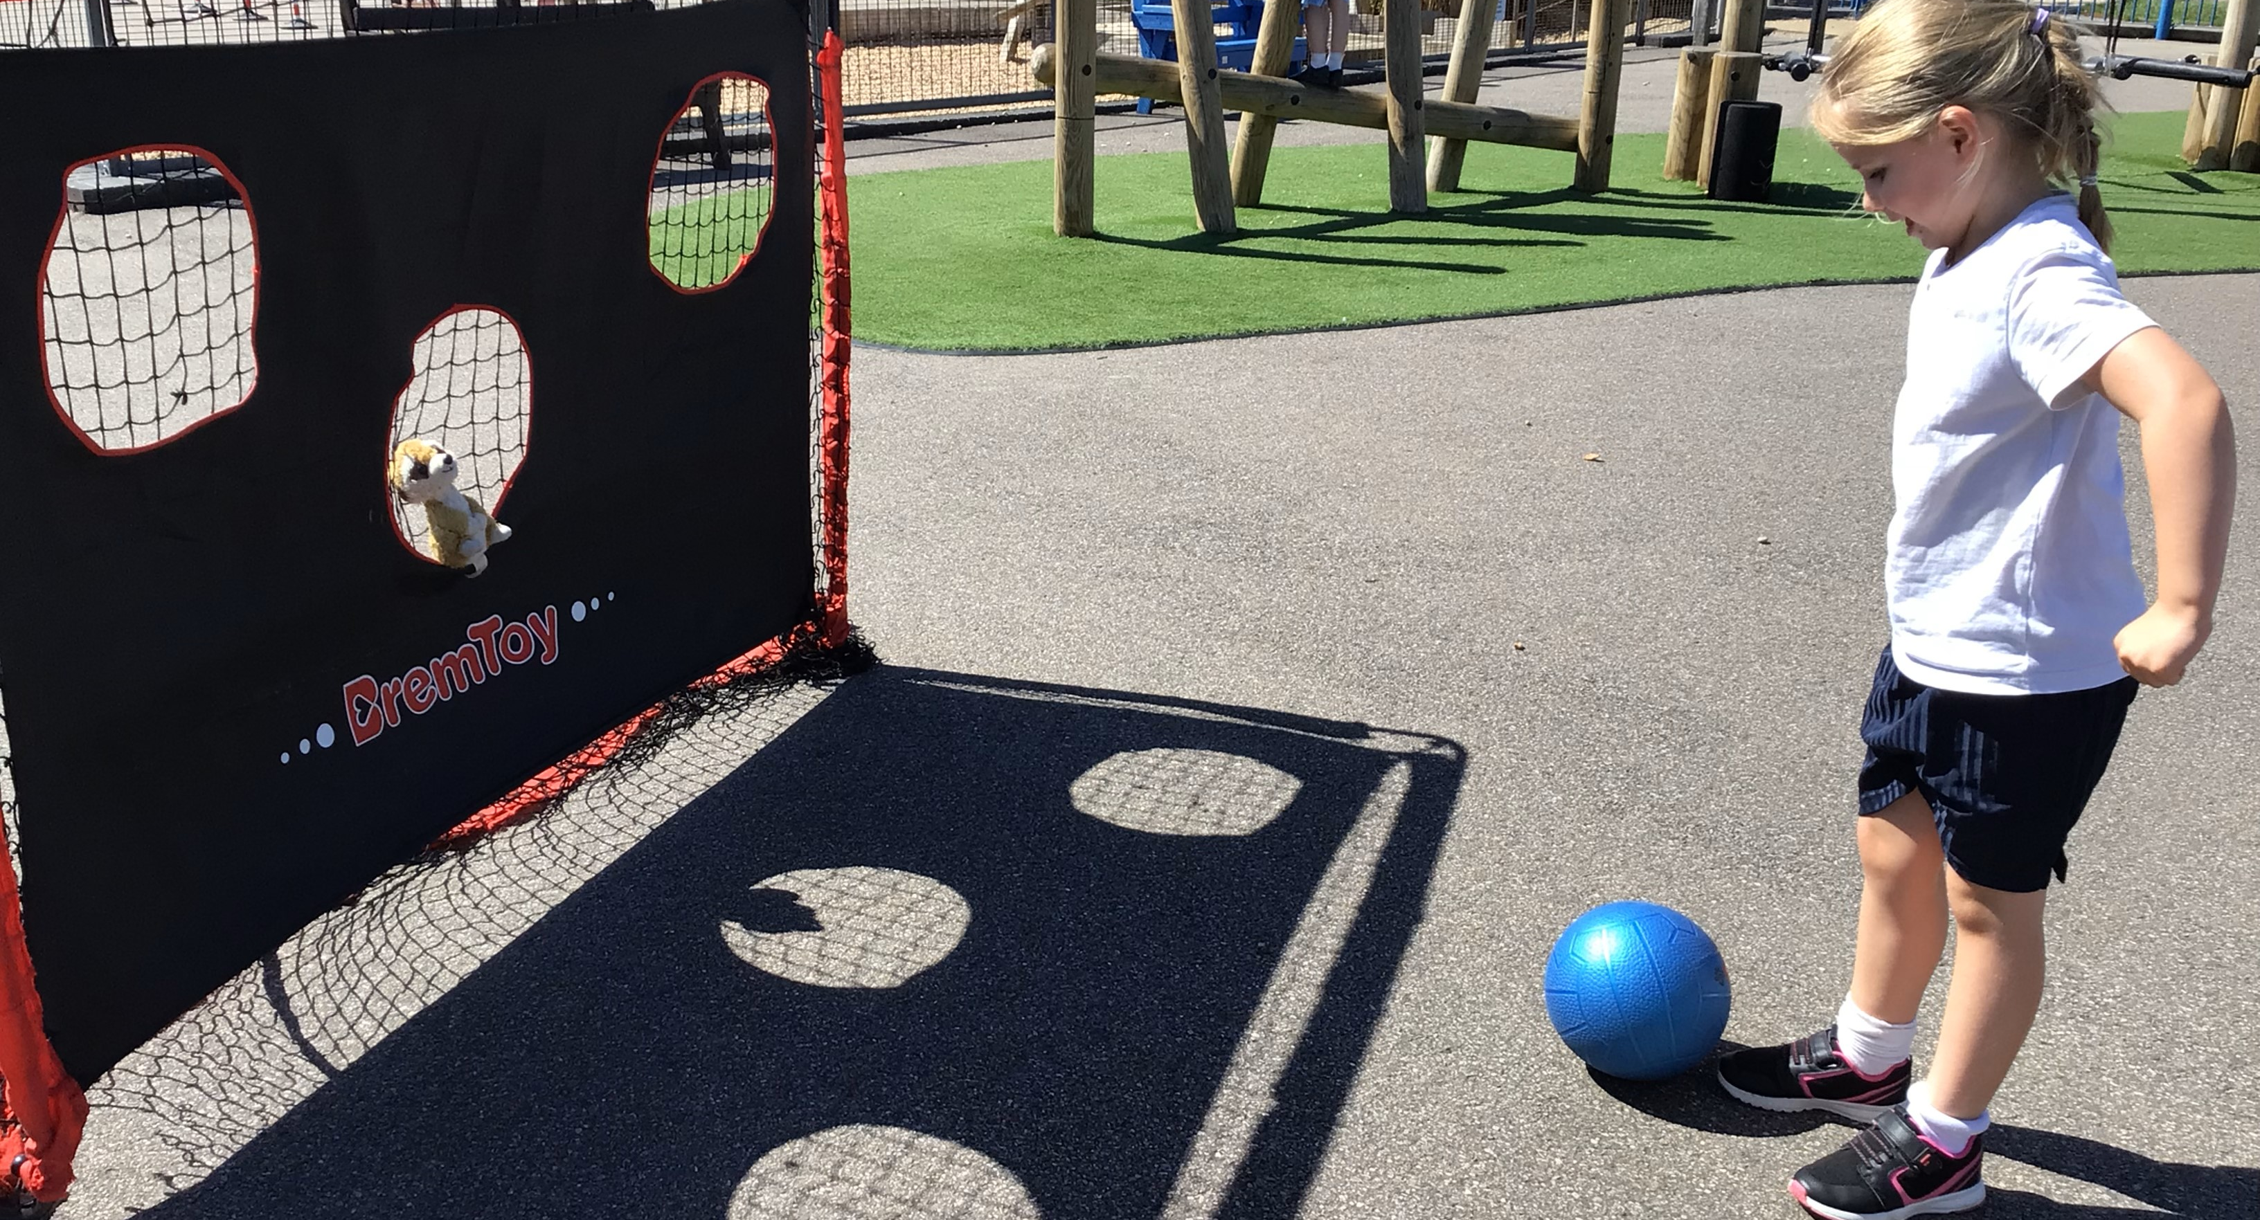
A Day in the life of a Year One Child! (Continued)
Math’s: Math’s lessons may also be taught in the morning. These will be whole class. In the Autumn Term we will be recapping Reception planning and building on their previous taught skills.
Lunchtime: In the hall (the same as in Reception)
Playtime: The children will have their playtime on the playground or on the field and will have access to the playground zones and equipment.
Foundation Subjects: Foundation subjects are linked to our creative curriculum. For example, in Long Long Ago the children make dinosaur sculptures in Art, whilst in the Big Blue and learning about pirates, the children make maps of the classroom in Geography!
PE: The children will have 2 PE lessons a week, one indoor (Gymnastics or Dance) and Outdoor (Outdoor Games). Class teachers will let you know which days your children will need to wear PE kit for PE.

Slide 5
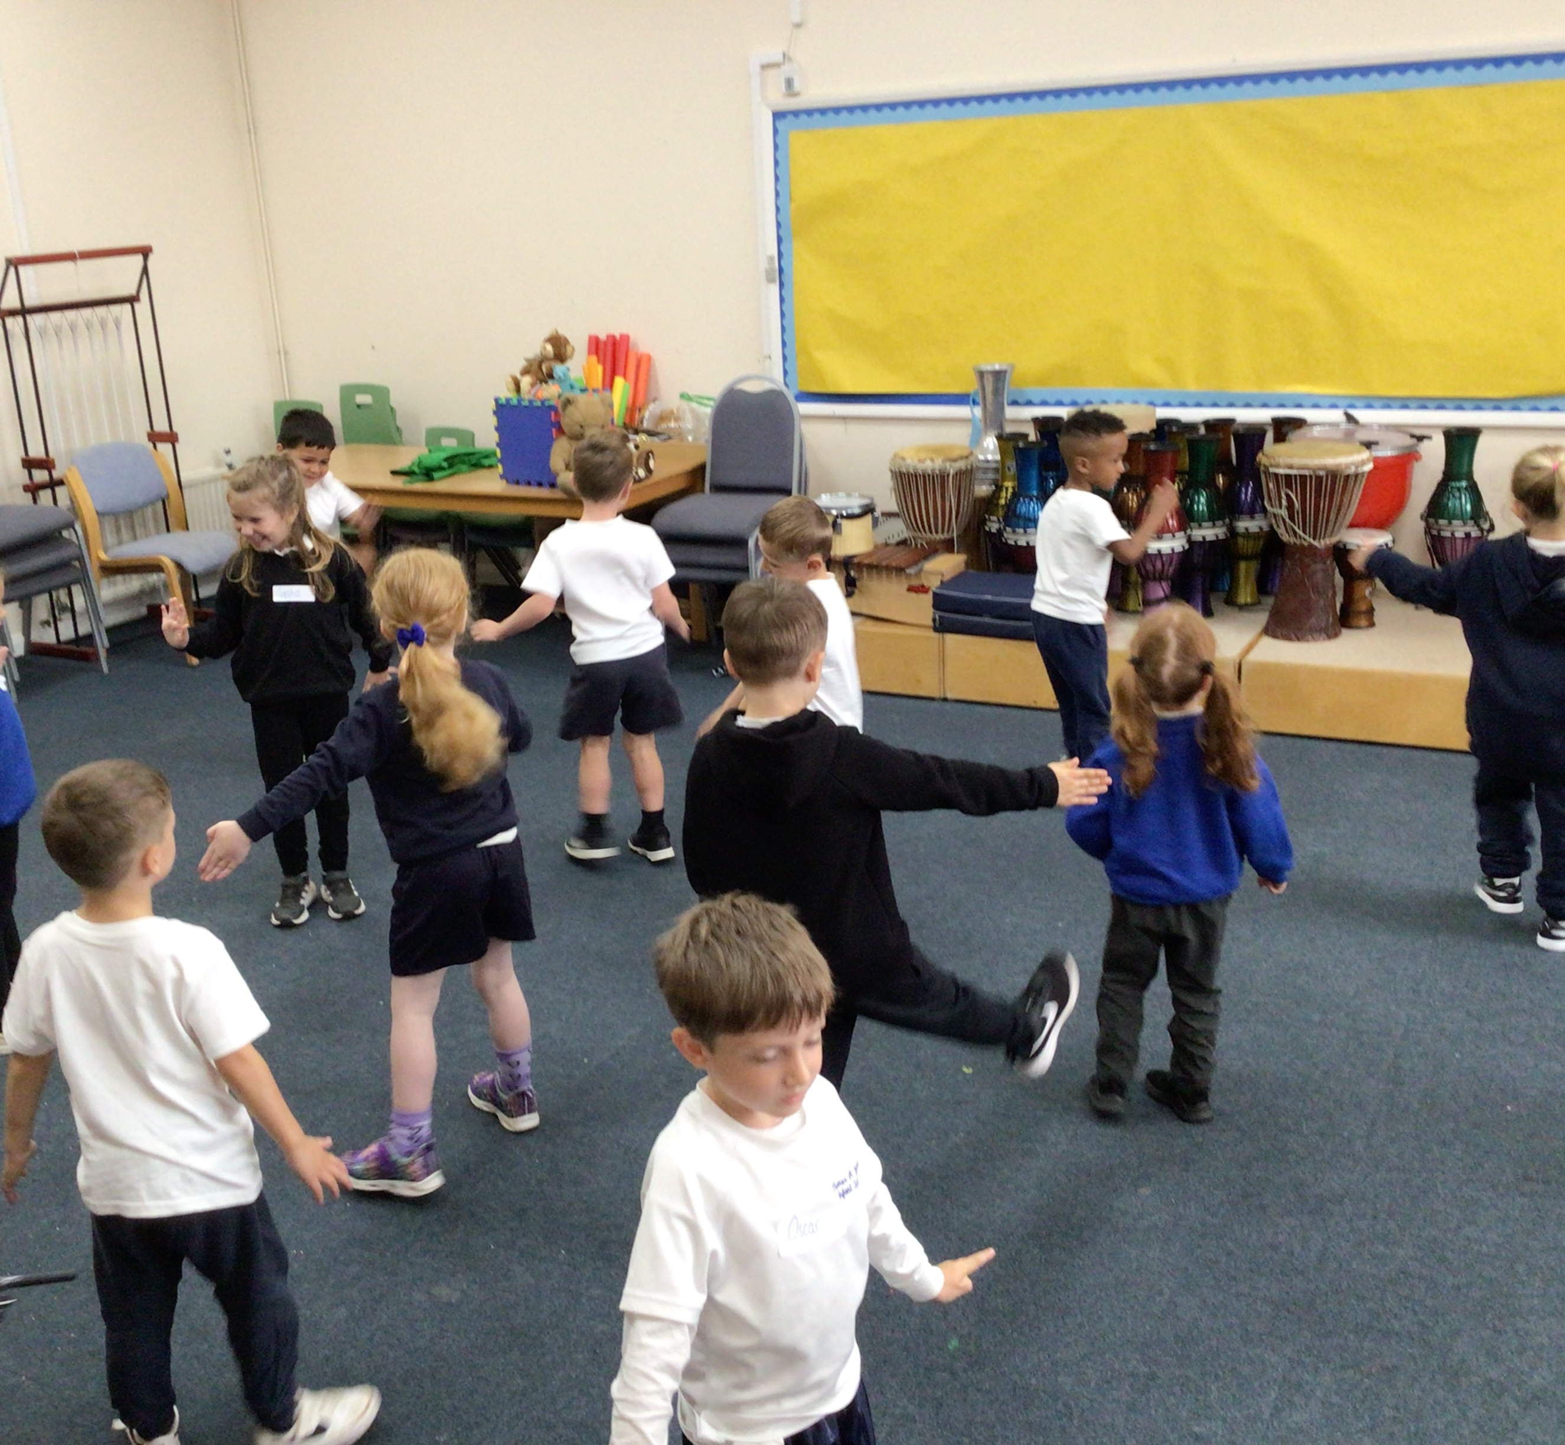
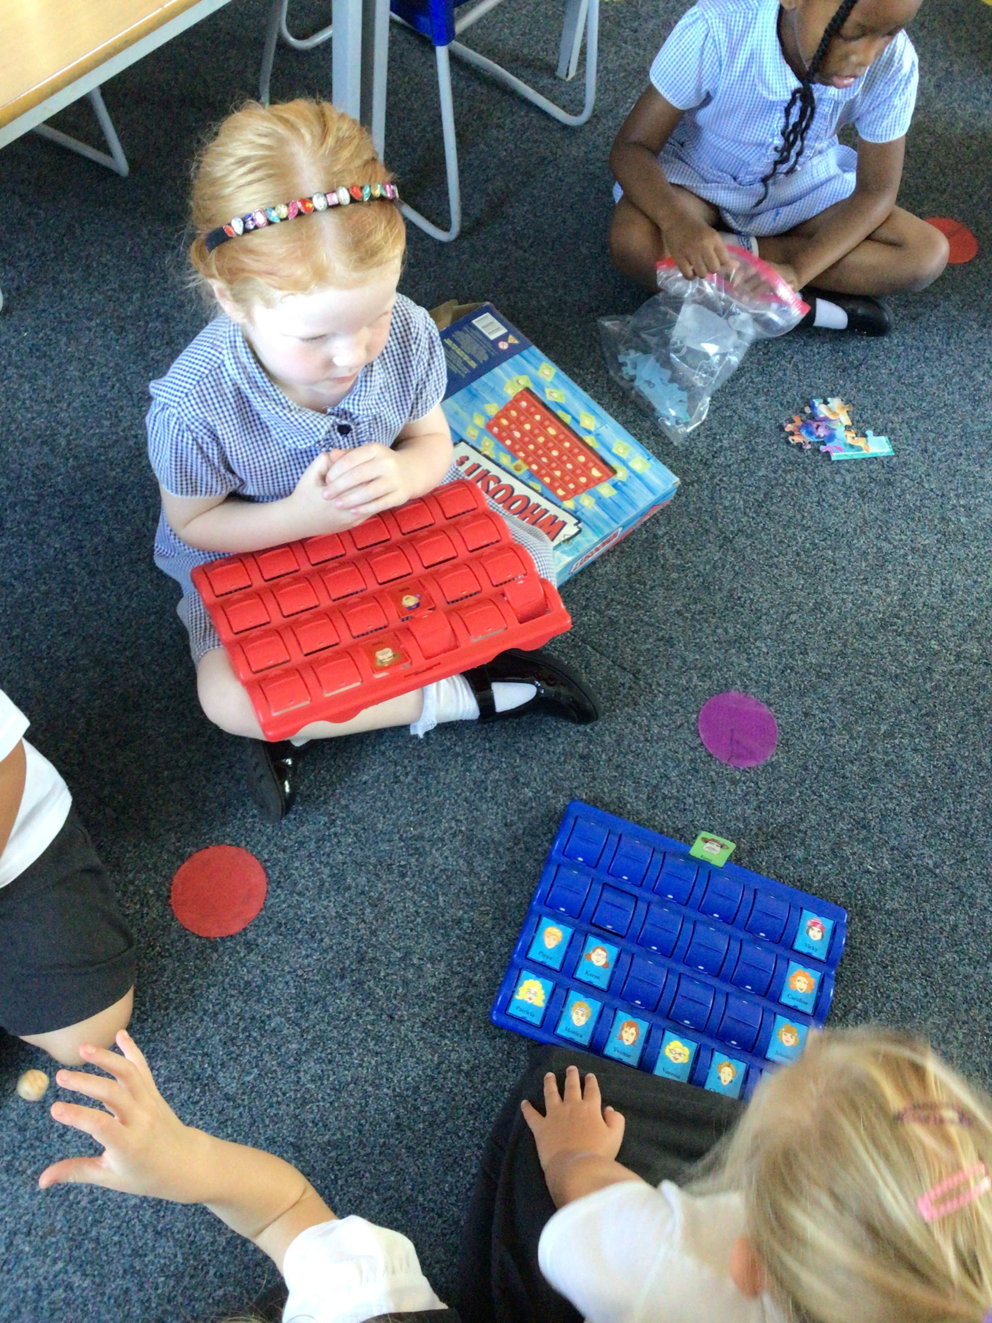
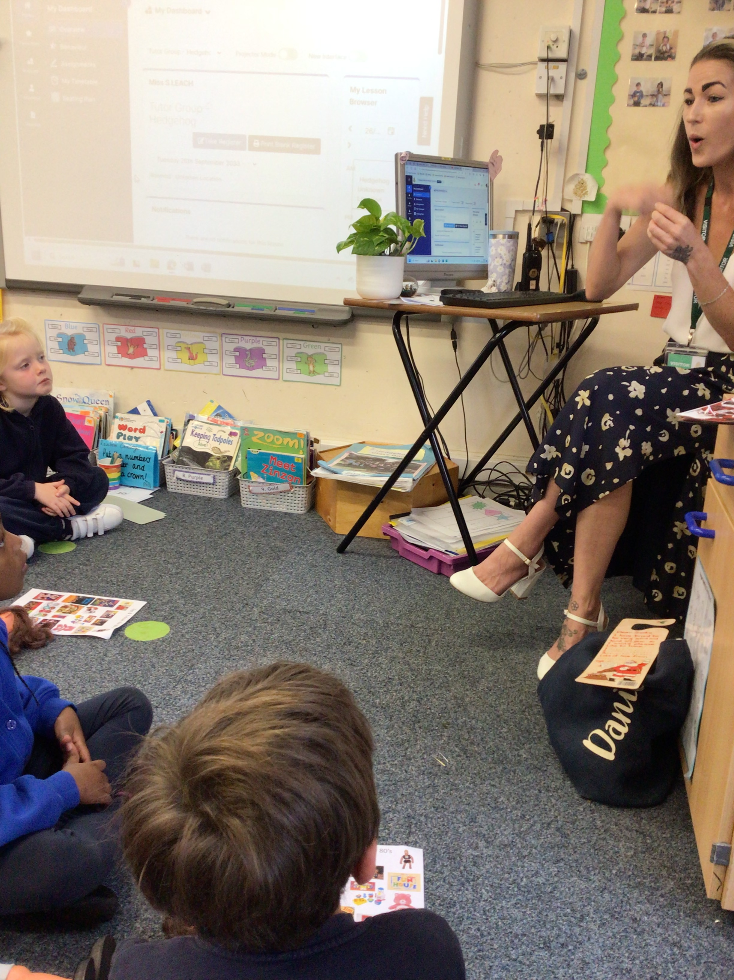
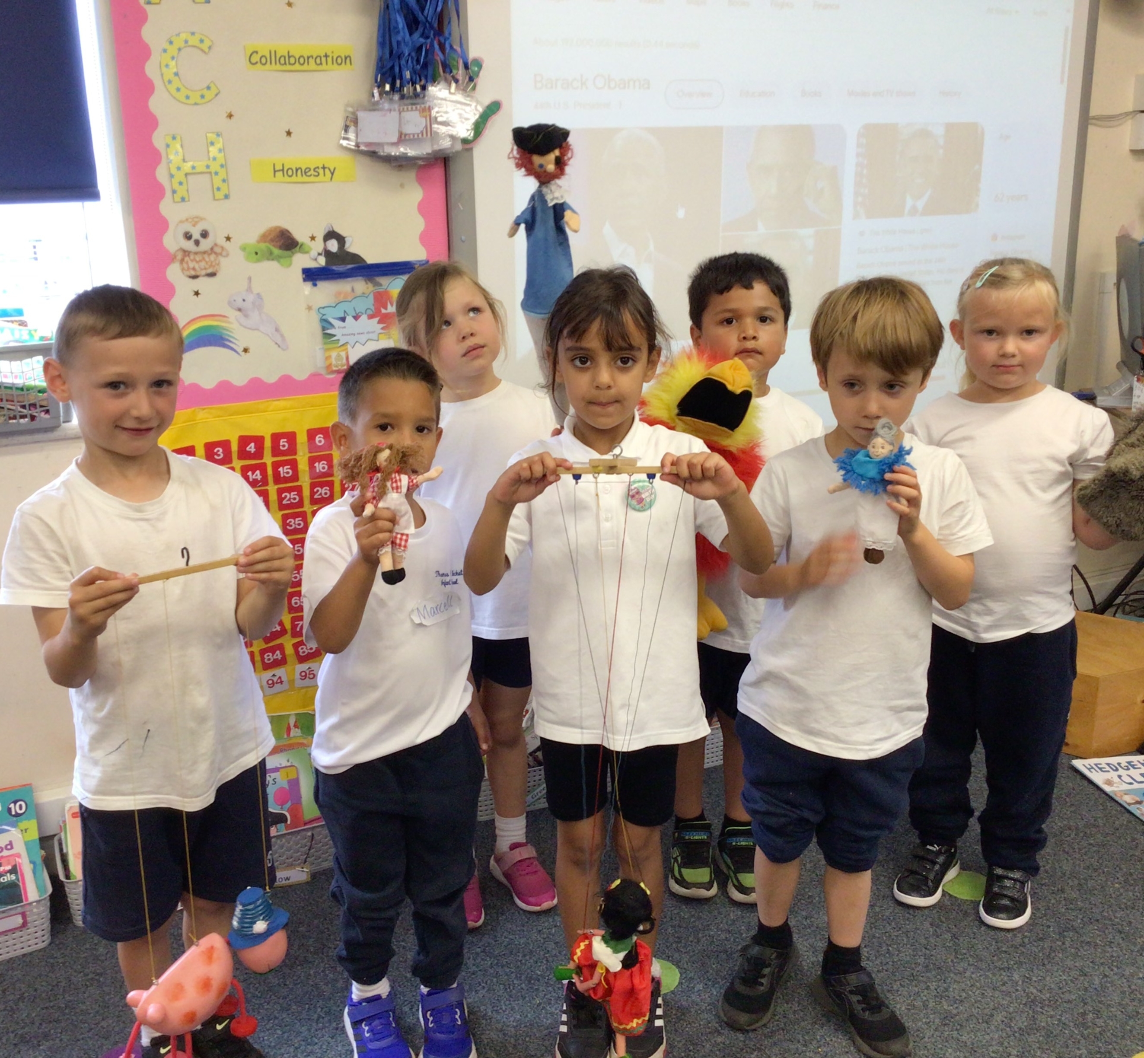
Autumn Term Themes!
Let’s Play
We begin the theme with an RSHE focus, supporting your child to settle into Year One. For the children’s first Stunning Start they will be asked to bring a toy in to play with a friend, focusing on how to play successfully.
Later in theme we will learn about old toys and will invite parents in to share their experiences of toys they used to play with.
We also will have a Magical Toy Museum come into school that teaches the children about toys through drama.

Slide 6
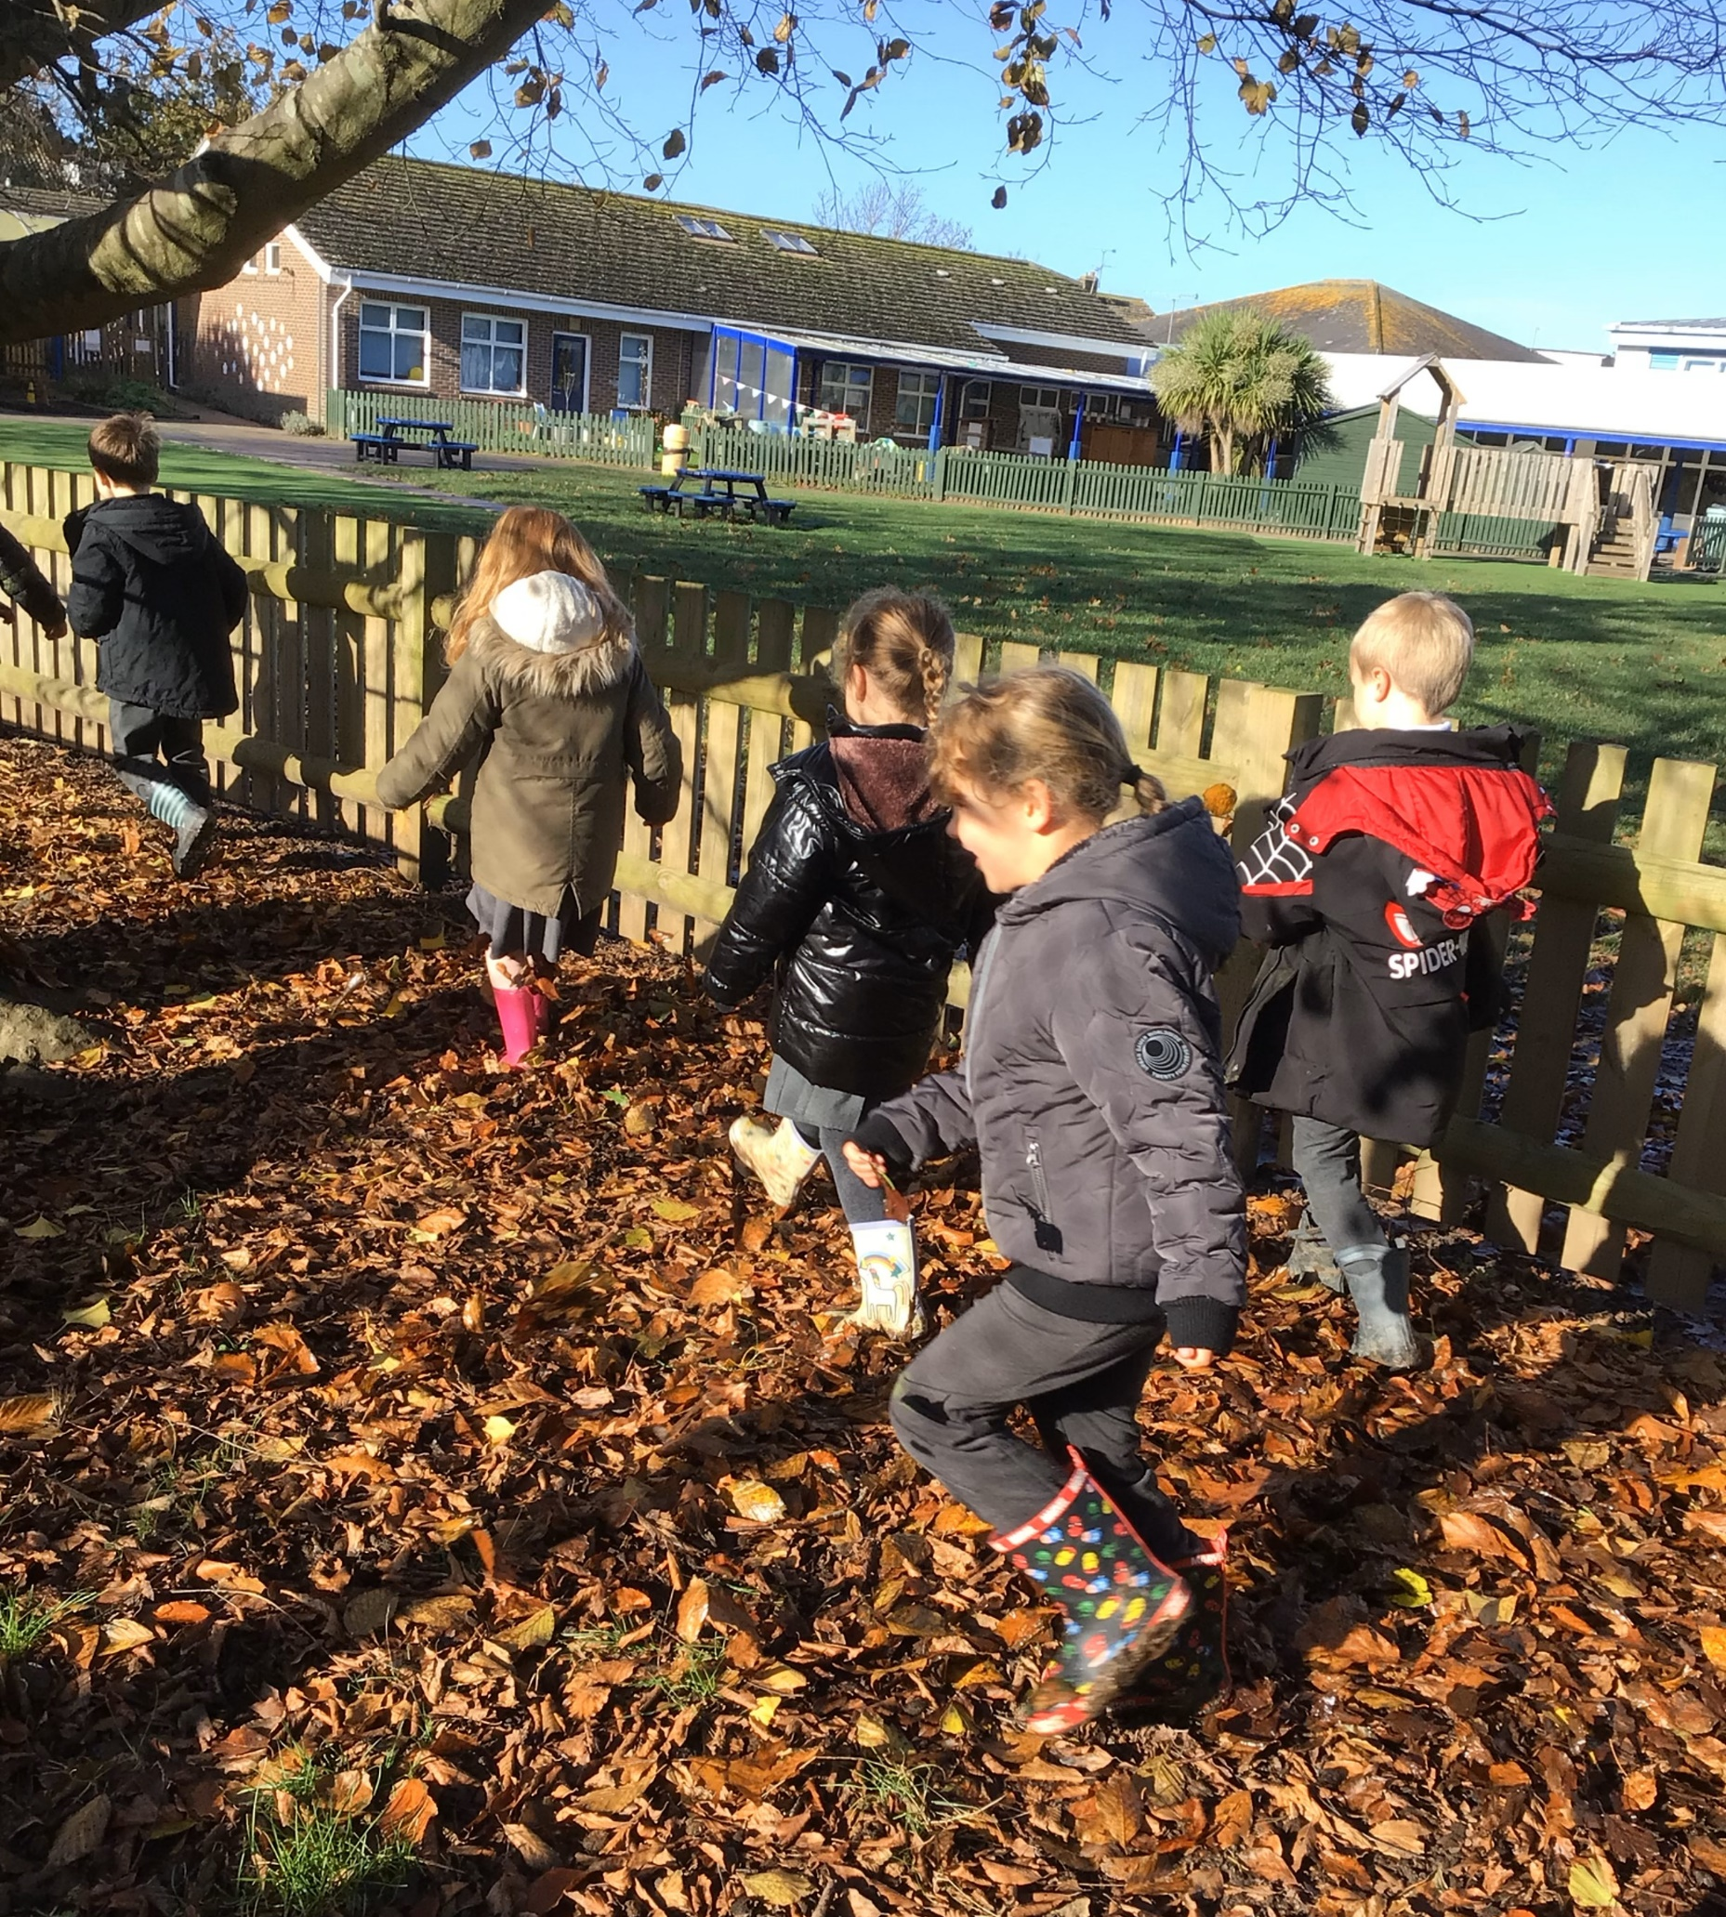
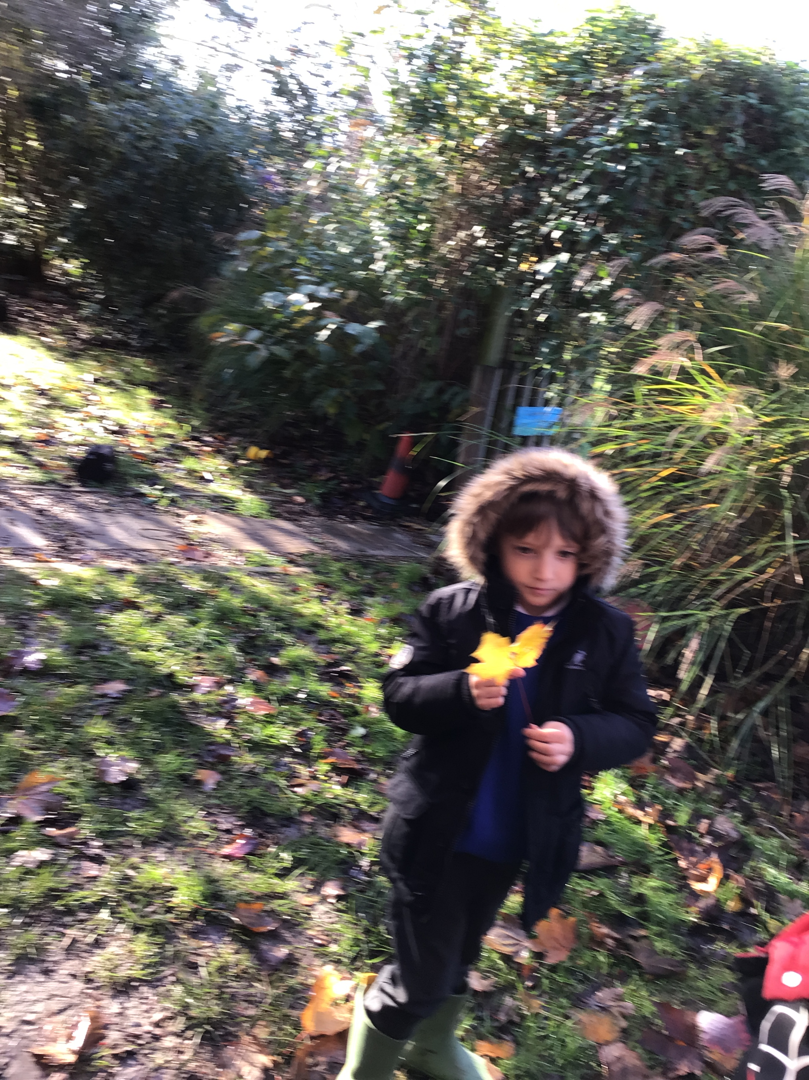
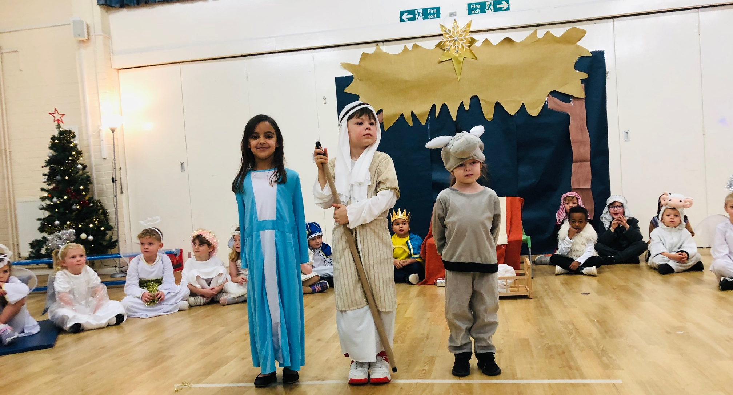
Autumn Term Themes!
Let’s Celebrate!
After October Half term the children will start by learning about celebrations and cultures from around the world.
Later in the theme the children will become meteorologists gathering data and information about the weather to present their own weather forecast. They will also look at seasonal changes and what the weather is like in Autumn and Winter.
As we get closer to Christmas the children will learn about the birth of Jesus in RE and will perform Whoopsy Daisy Angel Nativity to parents!

Slide 7
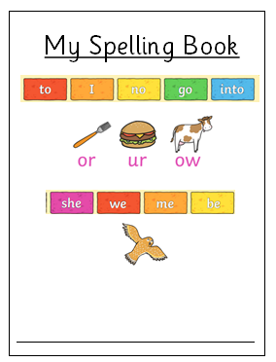
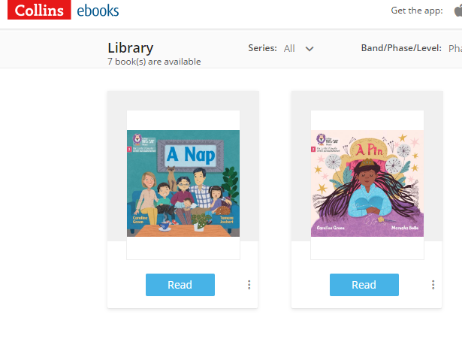
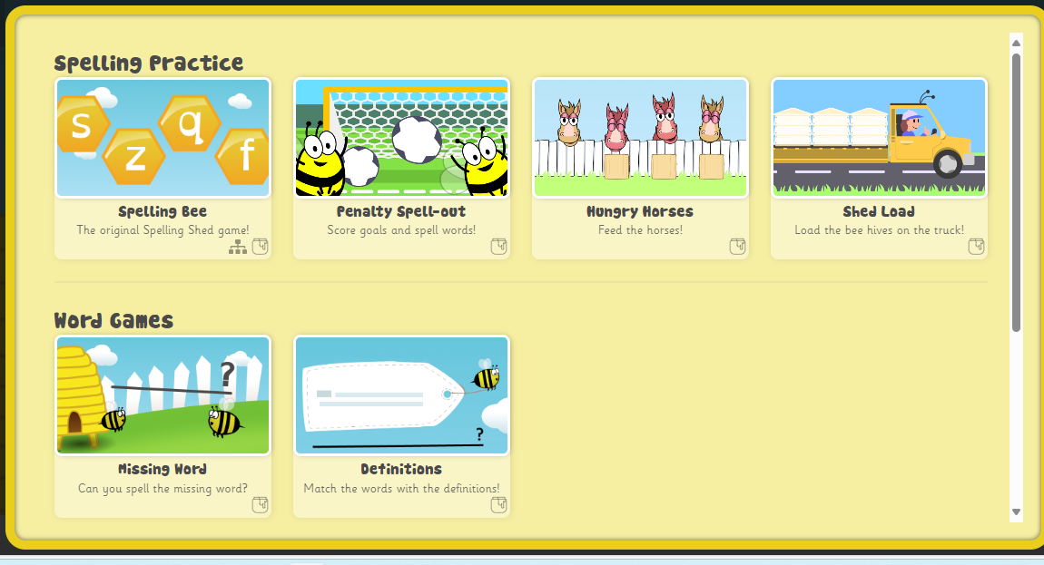
Home Learning in Year One
Every Friday we will send home your child’s Spelling Book which will have the tricky words and graphemes (sounds) we have taught that week.
Inside the Spelling Book will be a login to Spelling Shed where you child can play spelling games, practising the tricky words of the week.
Additionally, every 2 weeks your class teacher will assign a Big Cat reading book for your child to read. This book will be a book they’ve read in school with an adult.
*More information to follow in the Autumn Term when we do our Phonics Meeting for parents.

Slide 8
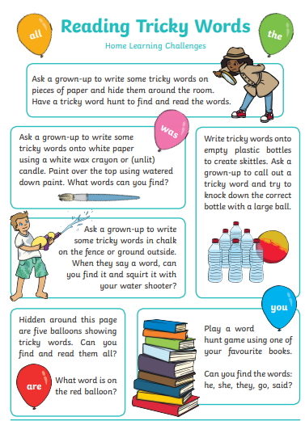
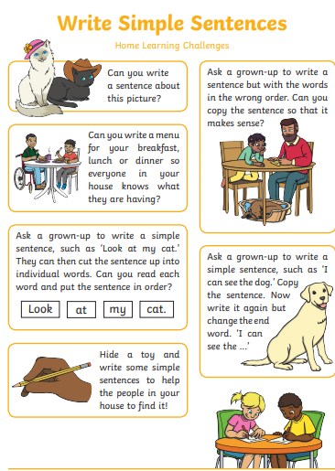
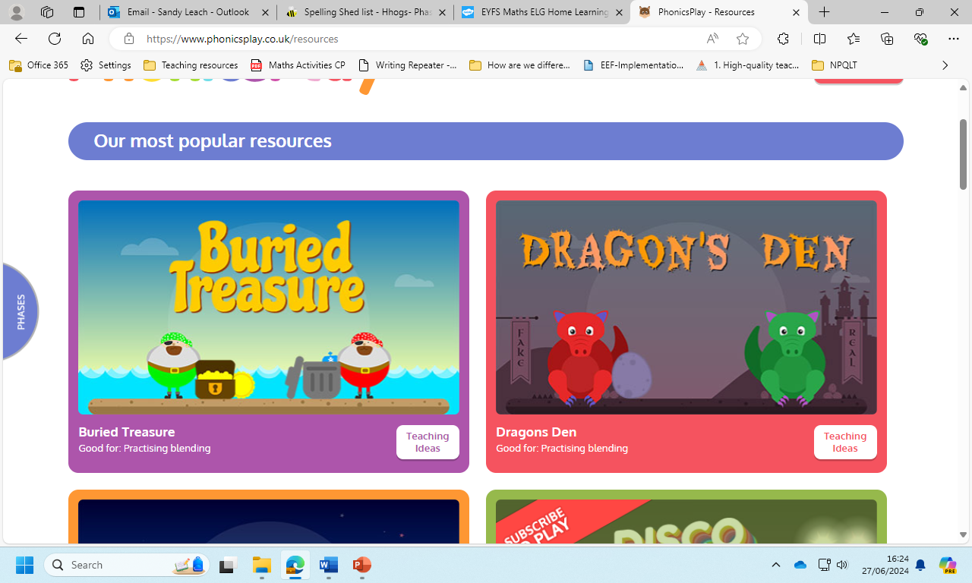
How can I help my child over the Summer Holidays?
Play phonic games with your child! (See School website for activity sheet)
Play phonic games on phonicsplay.co.uk
Practice spelling tricky words with your child.
Encourage your child to practice writing their name or a simple sentence (See School website for activity sheet)
Play number games with your child. (See School website for activity sheet)

